Slide 1

Codergirl – Frontend
Unit 2 - Class 9
Jan 6, 2021
Notes:
1

Slide 2
Agenda
Section 15 – Forms up to 199
Studio – Assignment # 6
Notes:
2

Slide 3
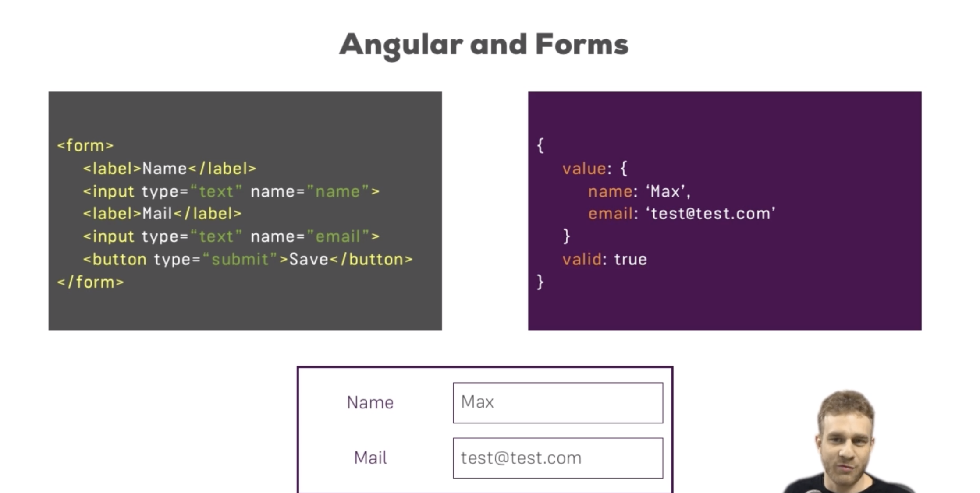
Forms
Display of form
Validation of form
Provides JS object representation of form.
Notes:
3

Slide 4
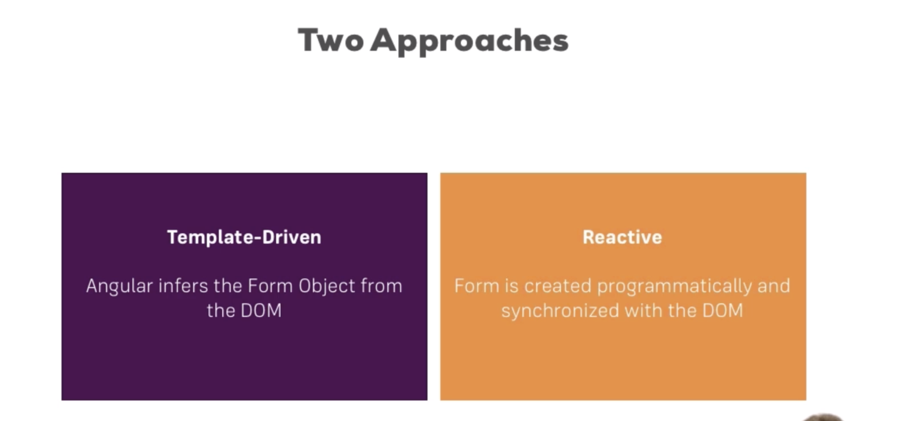
Notes:
4

Slide 5
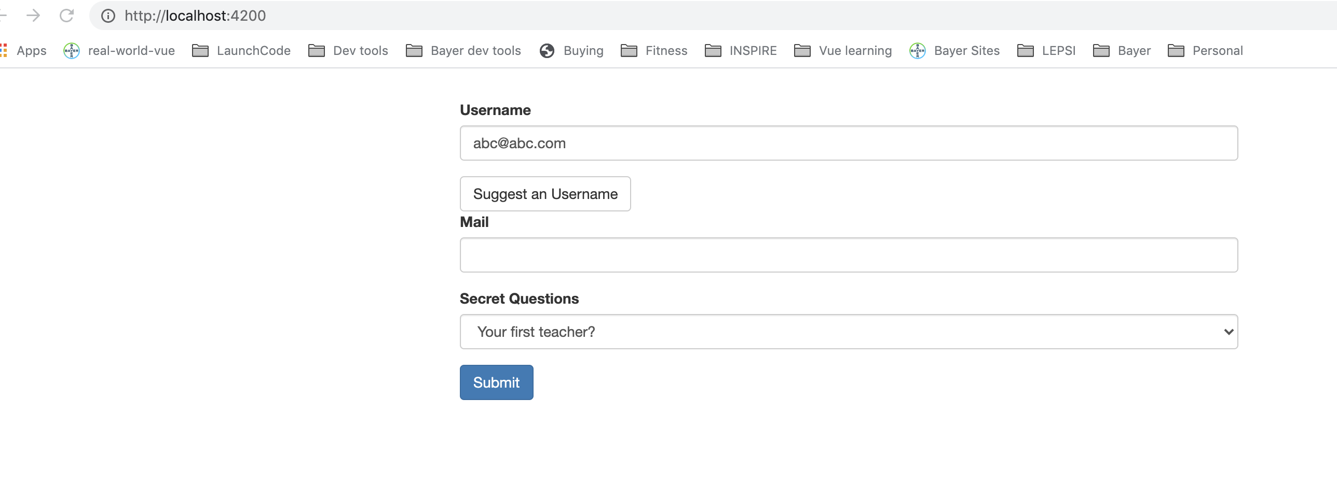
Forms
doesn’t trigger http submit Validation of form.
Notes:
5

Slide 6
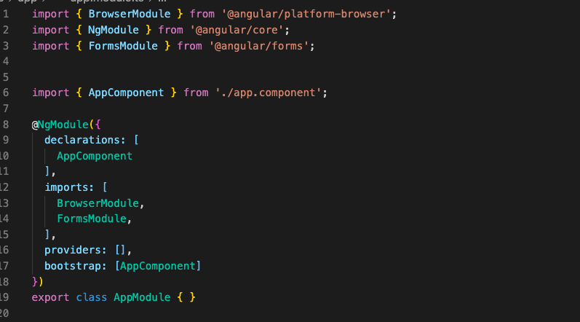
Forms
Notes:
6

Slide 7
Configure the form
Register the controls with ngModel and name.
Notes:
7

Slide 8
Submitting the form
Make the form submittable. Html JS submit event triggered and Angular provides a directive ngSubmit
Notes:
8

Slide 9
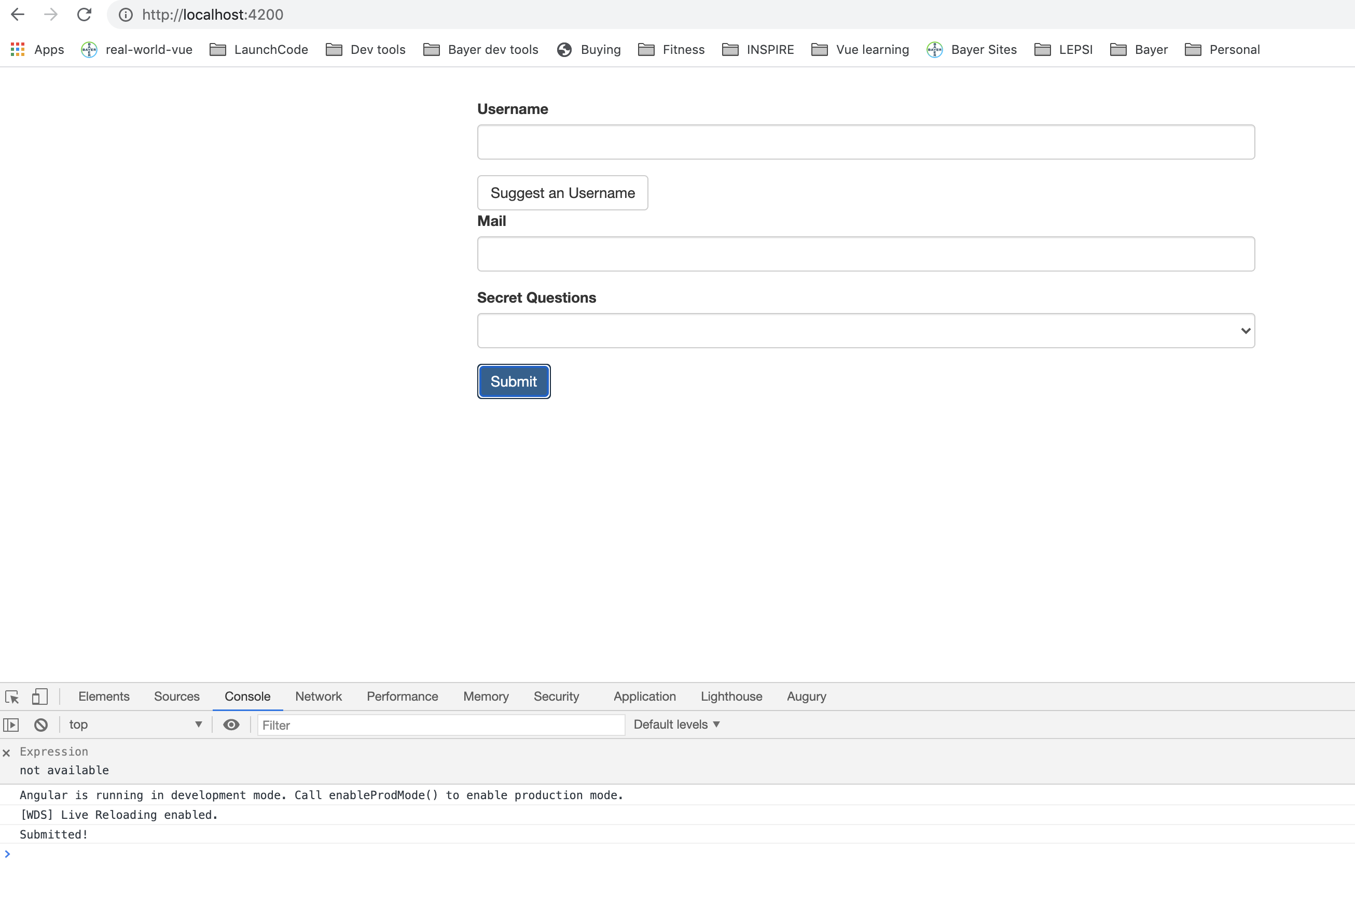
Submitting the form
Notes:
9

Slide 10
Submitting the form
Notes:
10

Slide 11
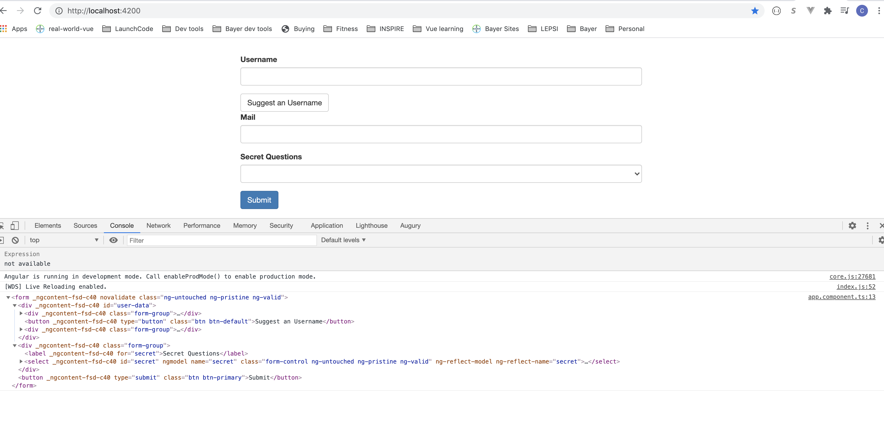
Submitting the form
Notes:
11

Slide 12
Submitting the form
Notes:
12

Slide 13
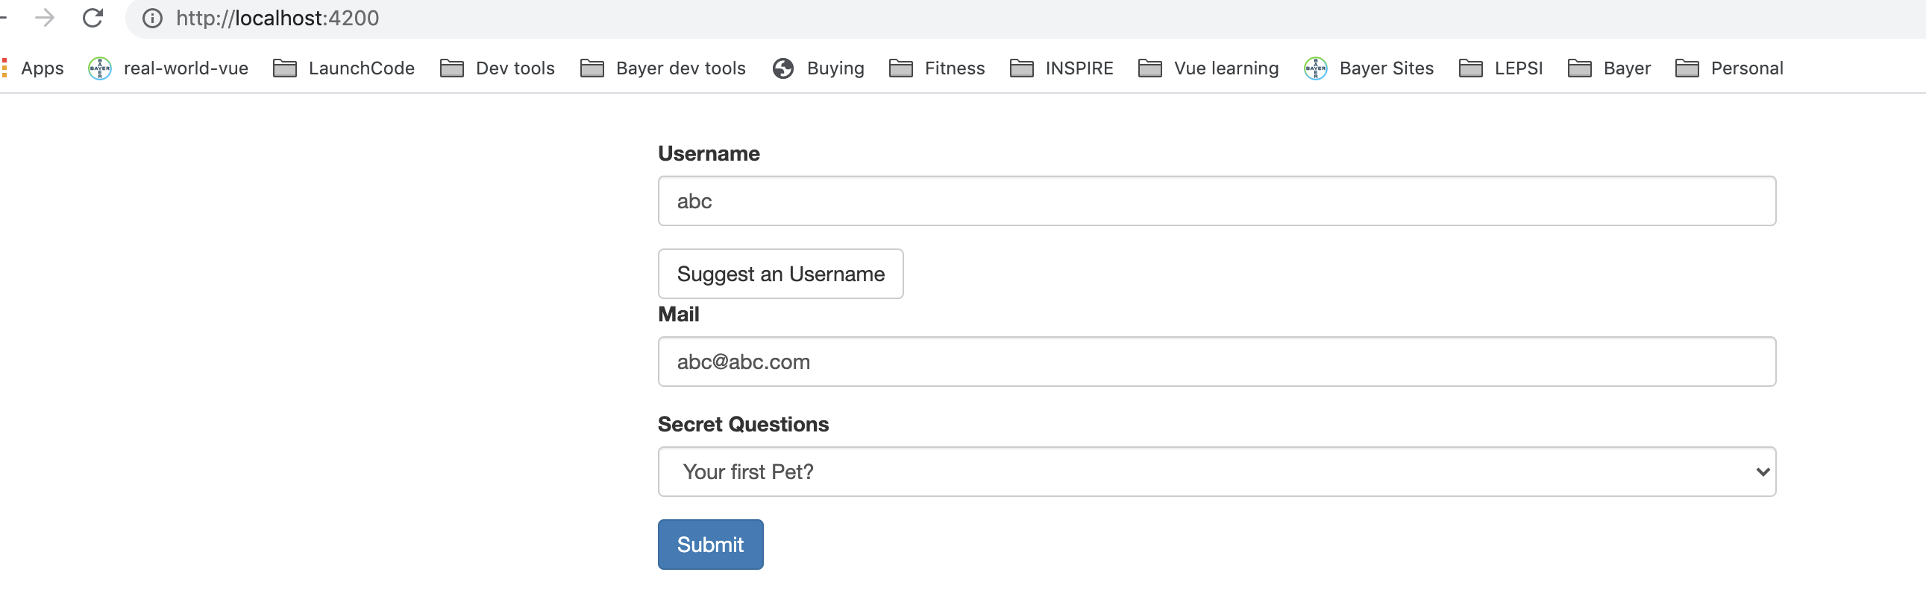
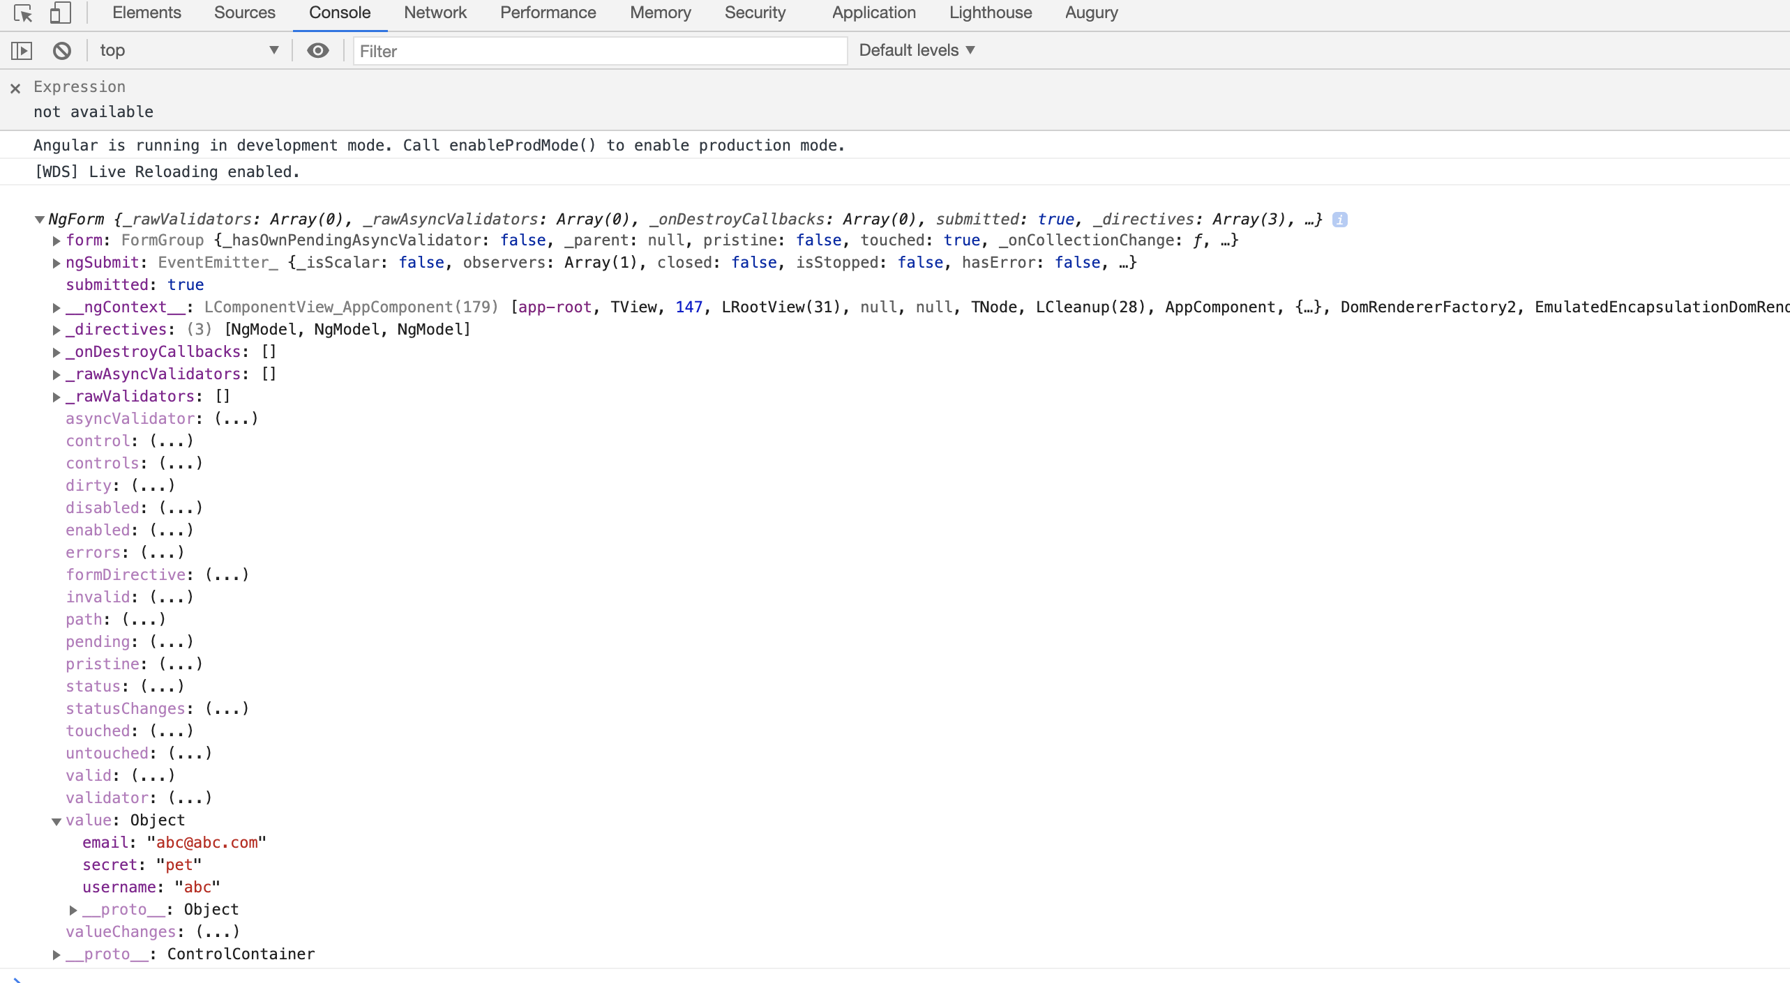
Value of the form
Notes:
13

Slide 14
Controls for form
Dirty means some vaklue is changed in form (user typed)
Disabled if form disabled
Invalid works with form validations
Touched is true if clicked into form
Notes:
14

Slide 15
Local reference is available in Form
Notes:
15

Slide 16
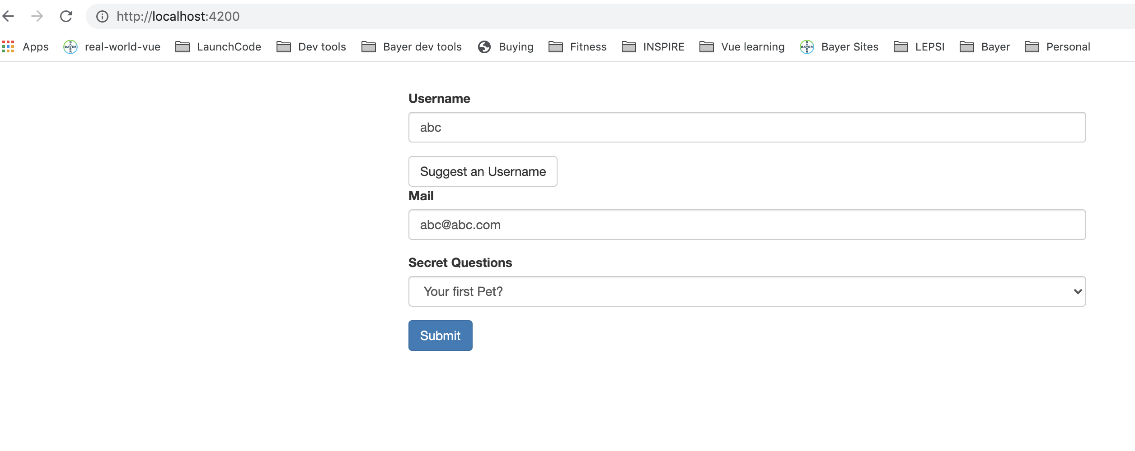
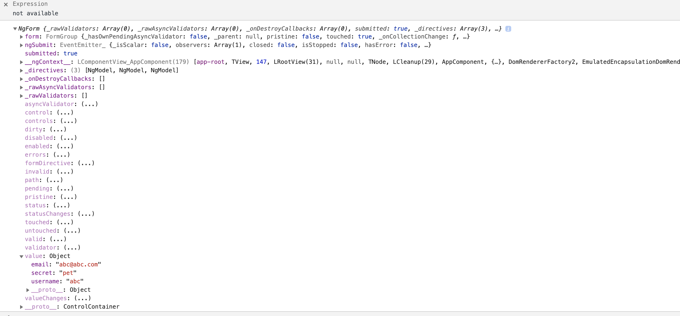
Local reference is available in Form, also can be available before form is submitted
Notes:
16

Slide 17
Form Validations
Template driven approach adds validation to template.
Built in directives
required is selector
email
Notes:
17

Slide 18
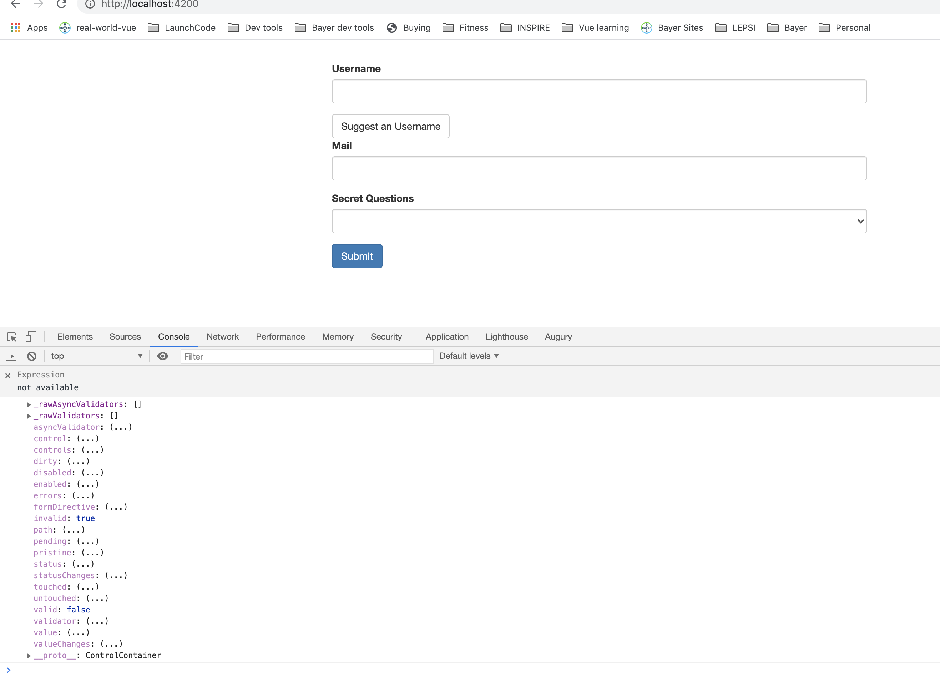
Form Validations
Notes:
18

Slide 19
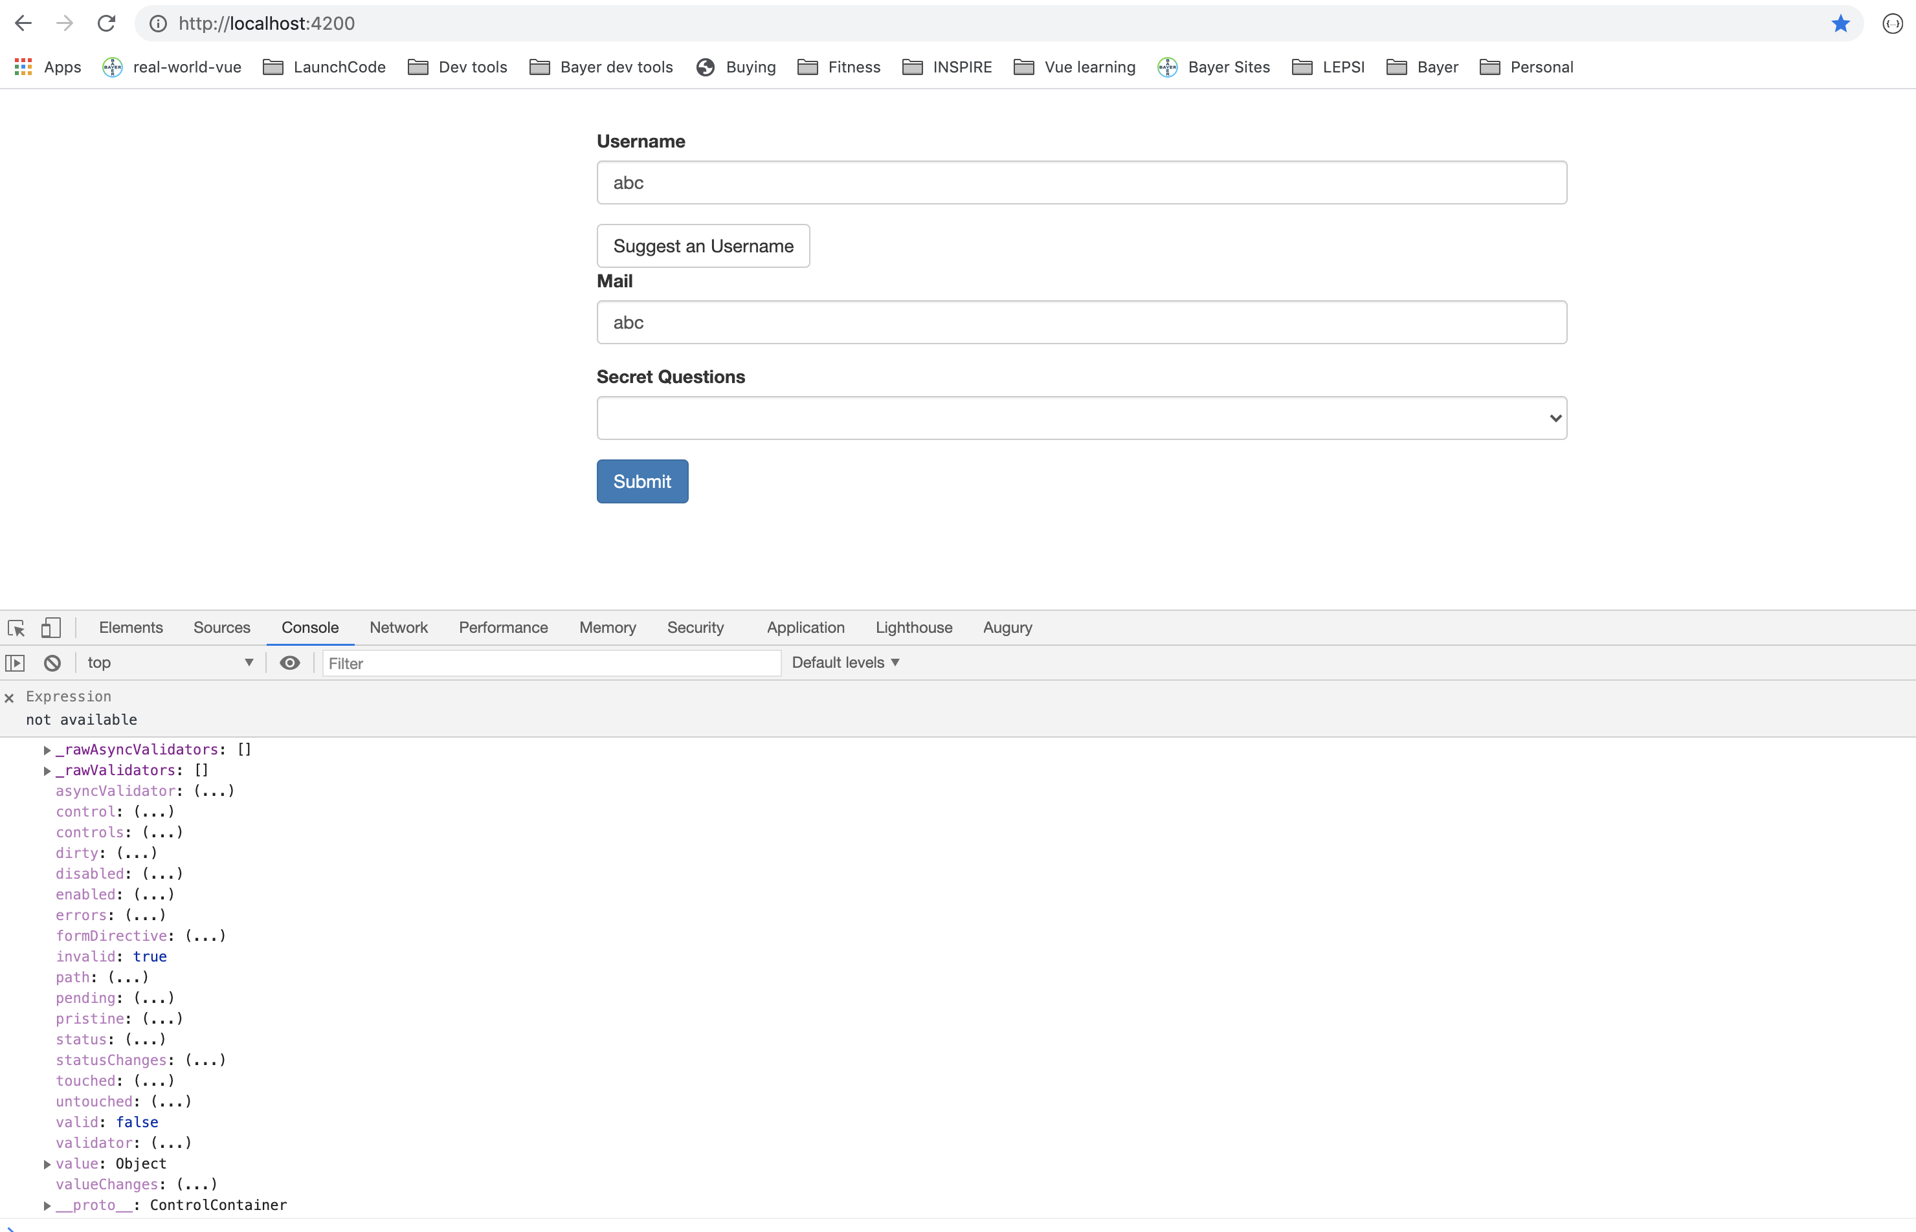
Form Validations
Notes:
19

Slide 20
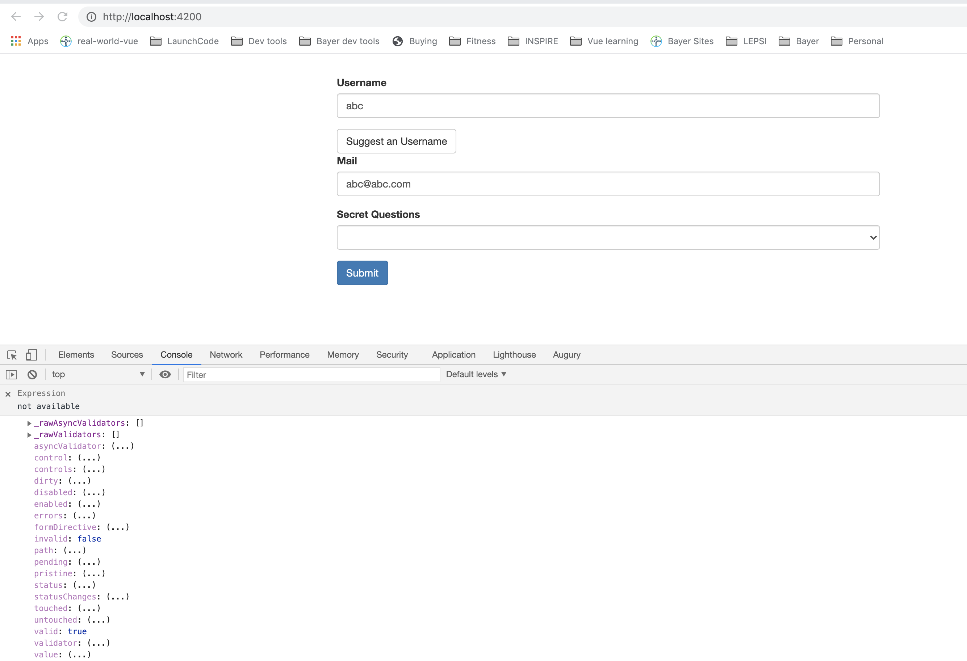
Form Validations – email form control also has valid set to true.
Notes:
20

Slide 21
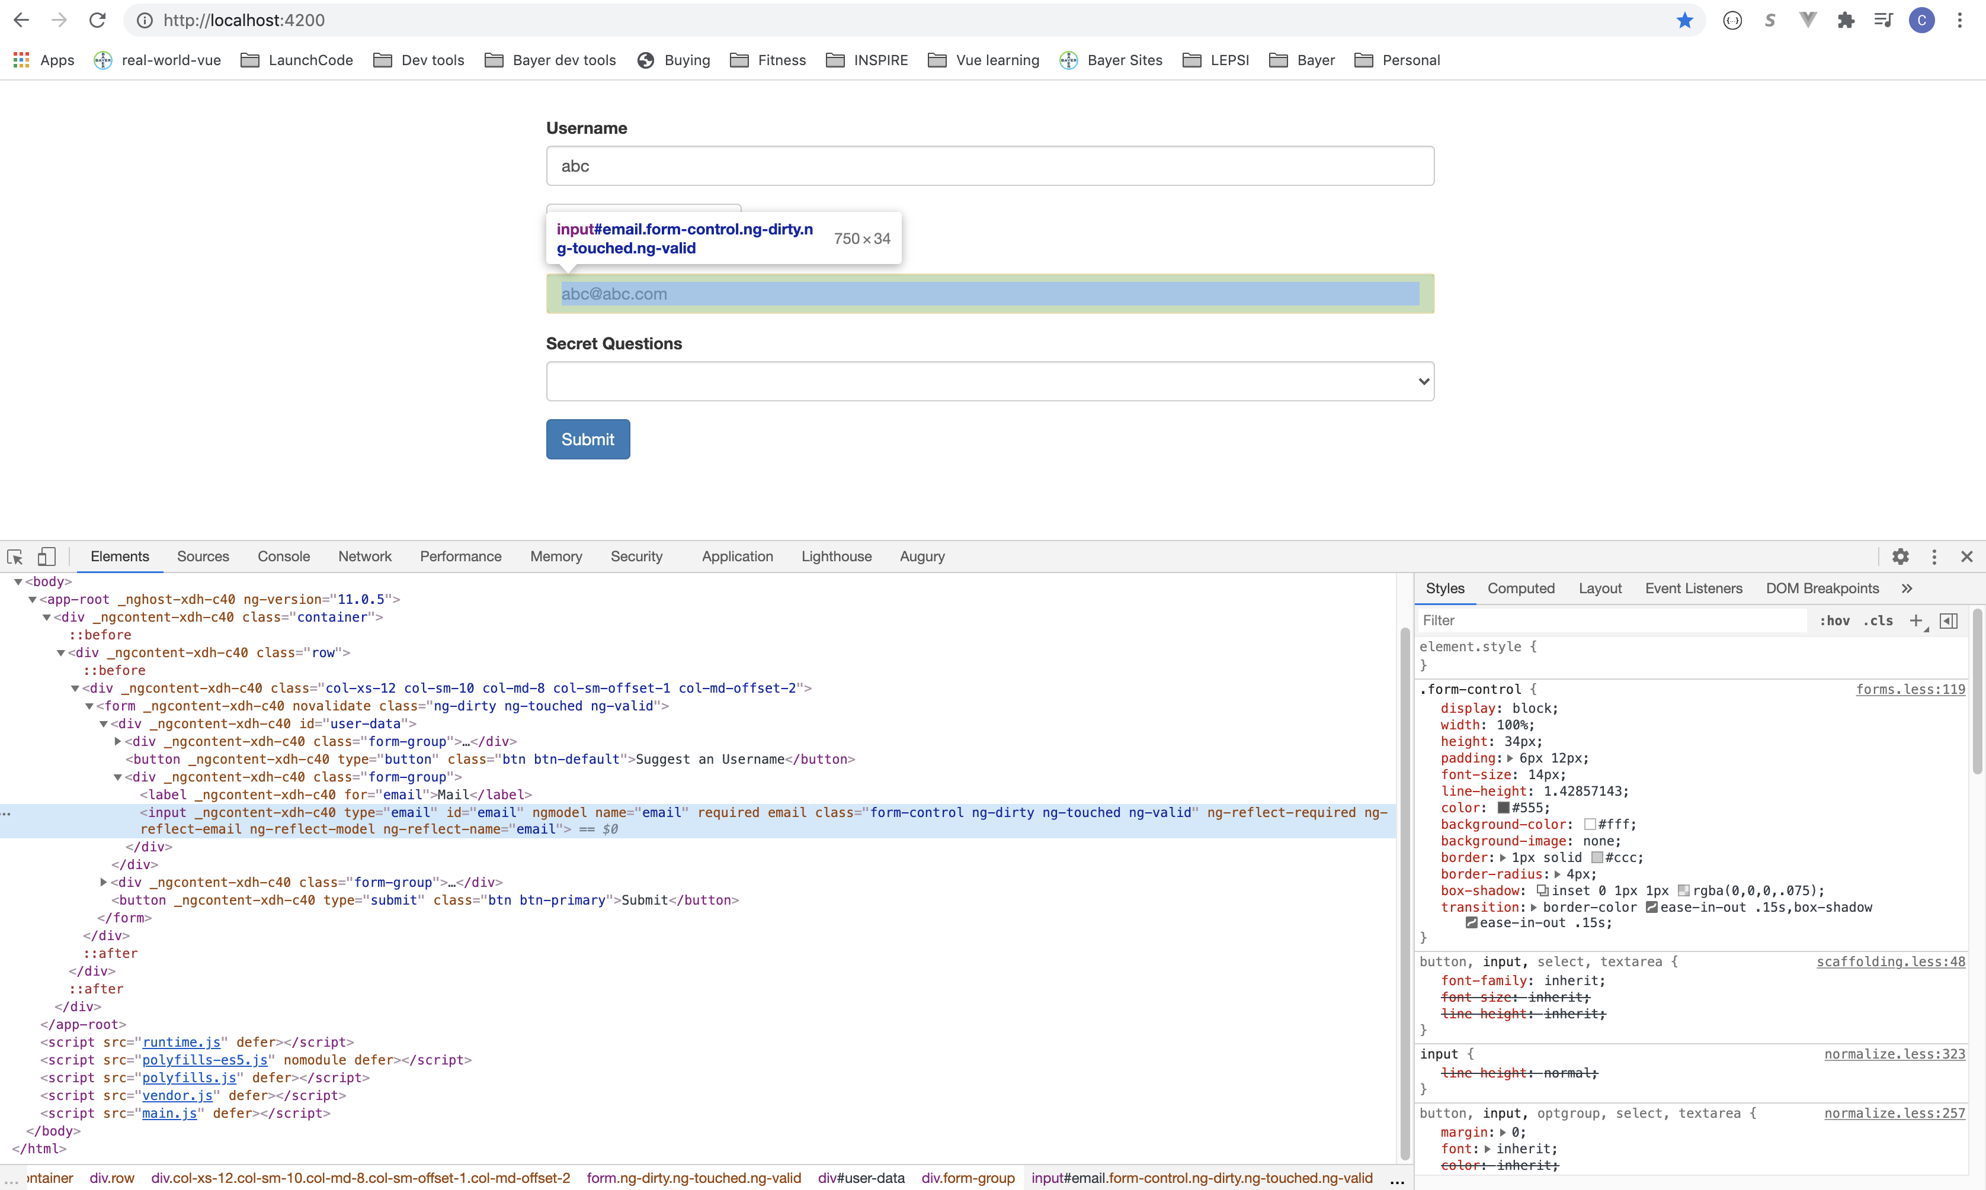
Form Validations – Angular adds some attributes to the elements.
Notes:
21

Slide 22
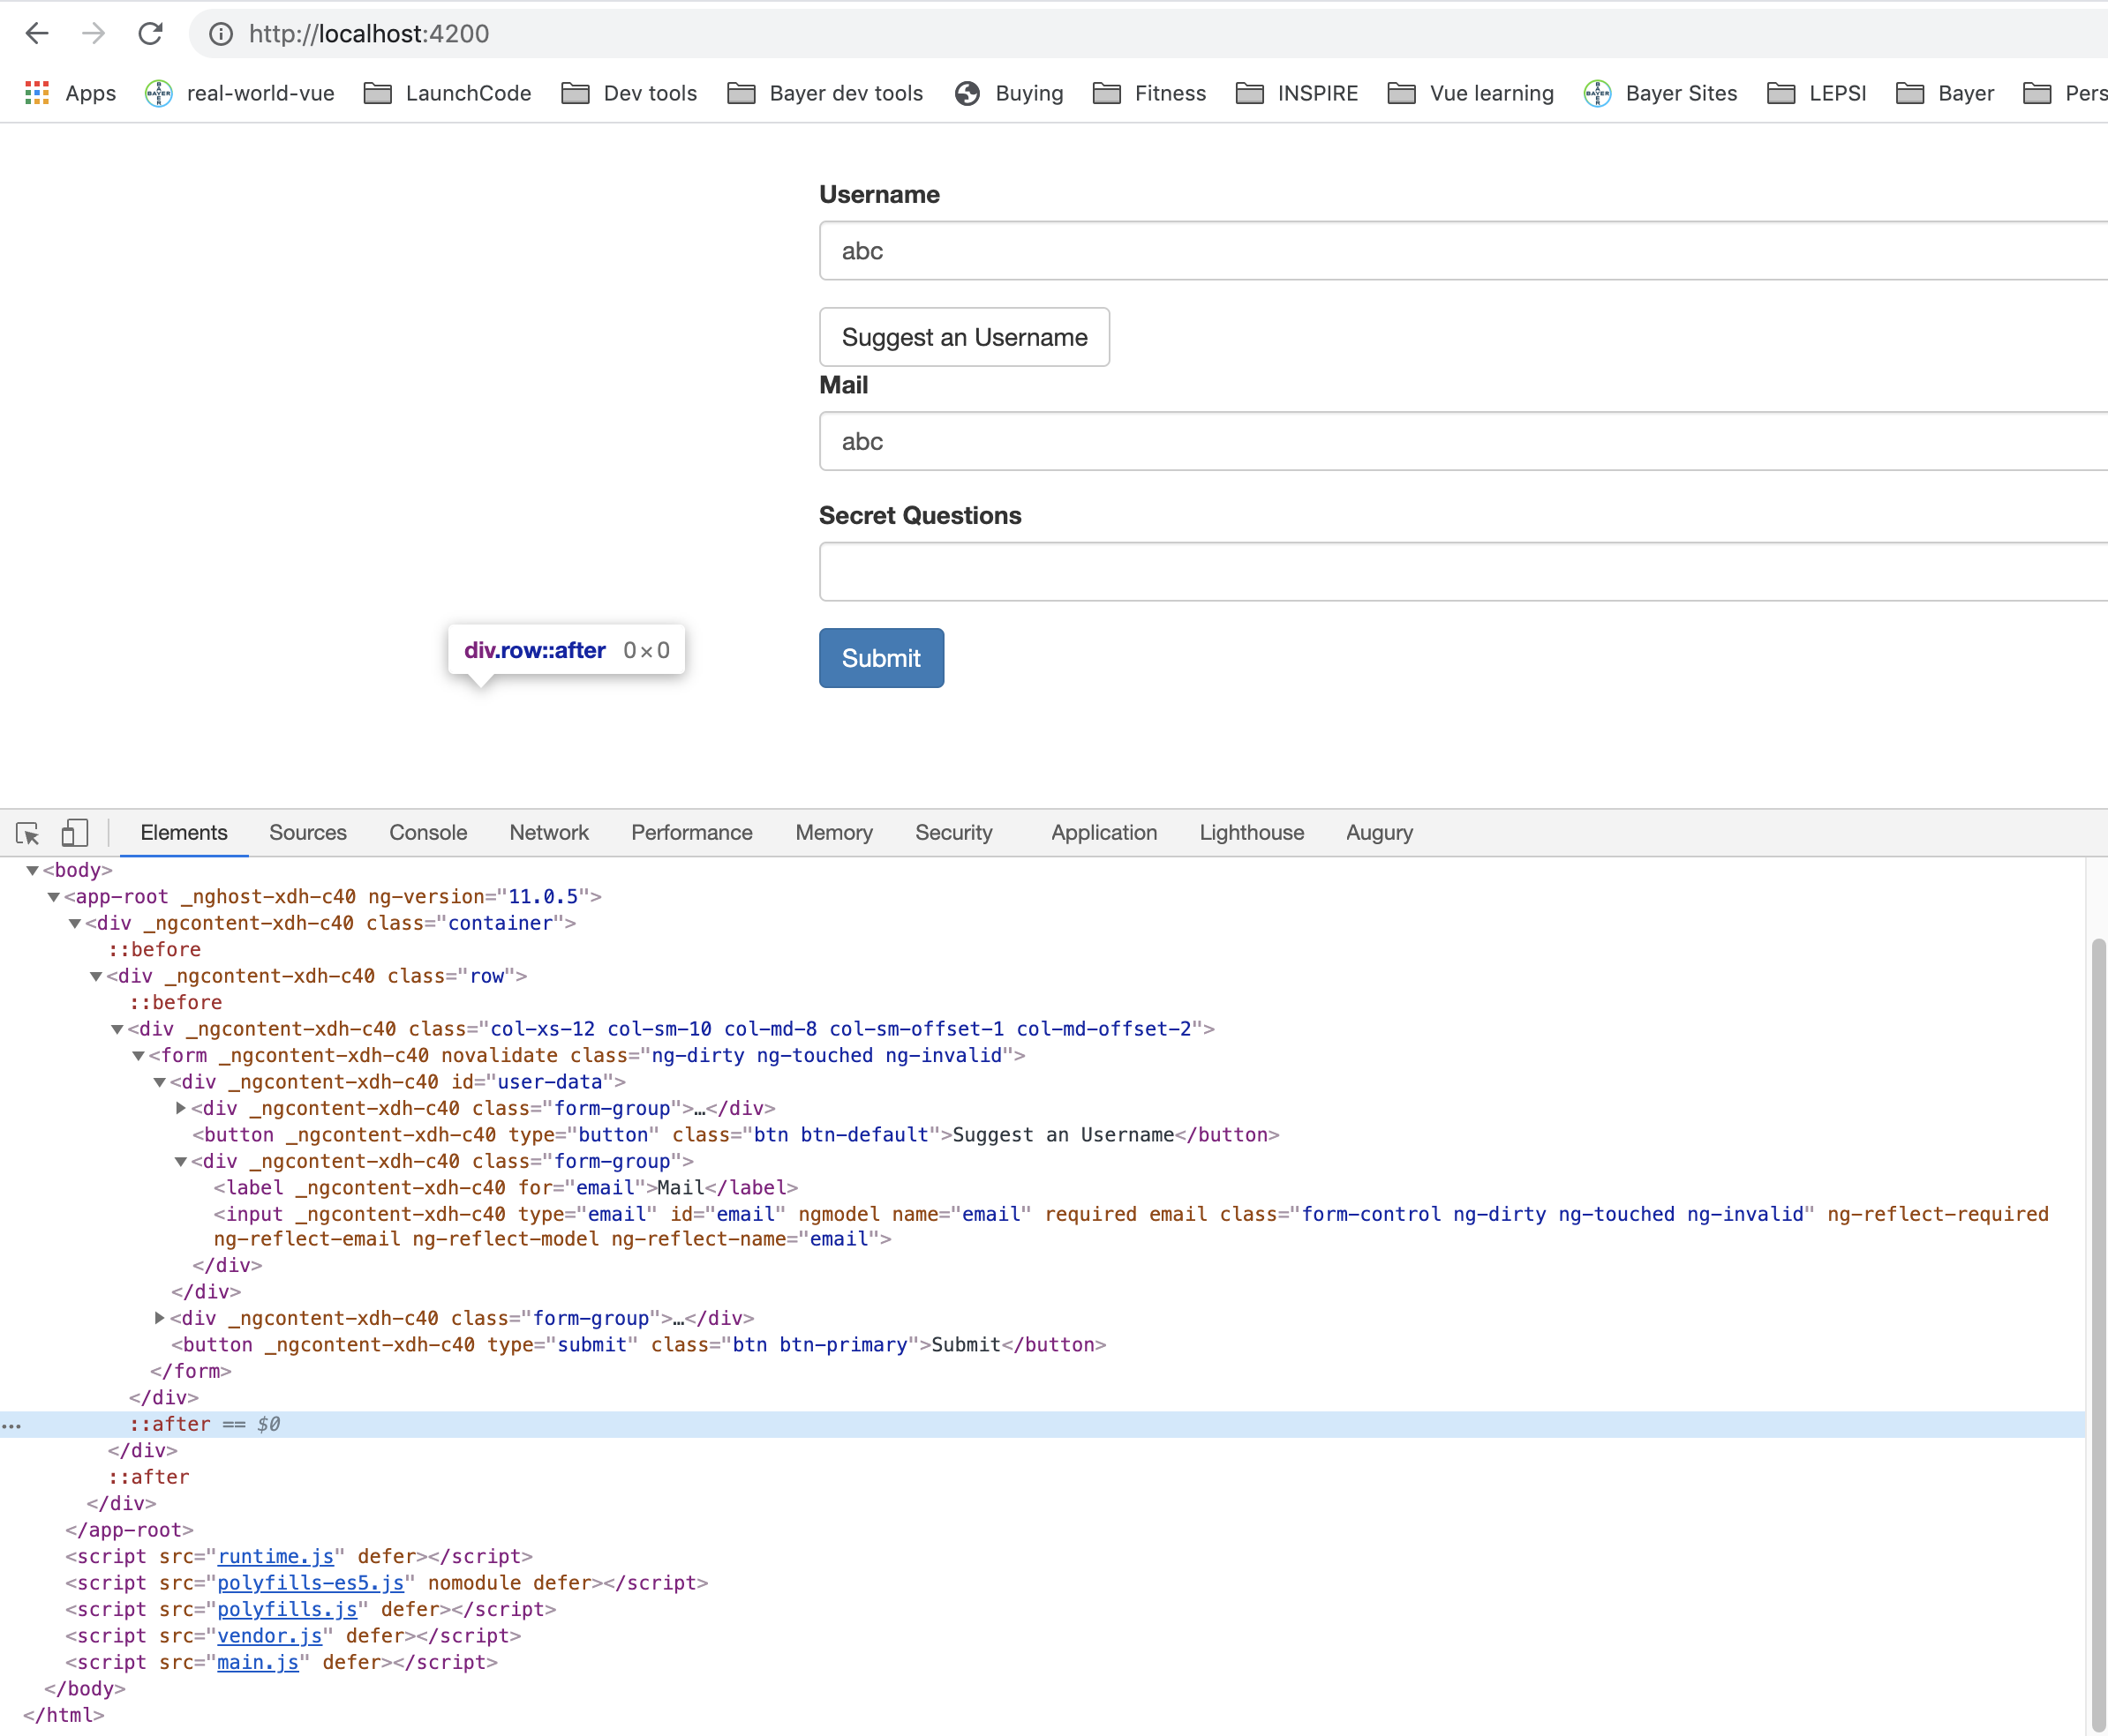
Form Validations – Angular adds some attributes to the elements.
Notes:
22

Slide 23
Change form behavior on validation result.
Disable submit button if form is invalid.
Notes:
23

Slide 24
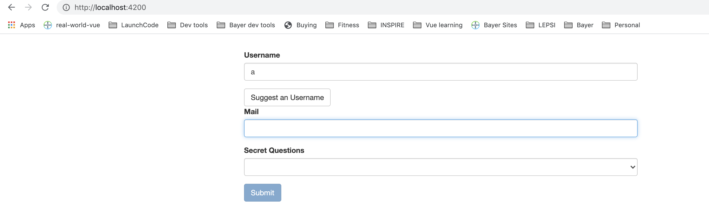
Submit disabled for invalid form.
Notes:
24

Slide 25
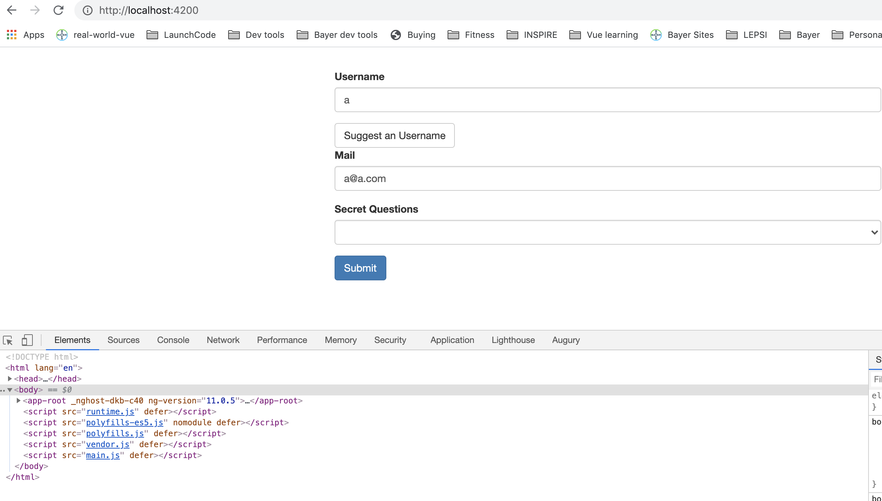
Submit not disabled for valid form.
Notes:
25

Slide 26
Change styling
The form is also invalid, so conditional styling needs to be applied just to element not entire form.
Notes:
26

Slide 27
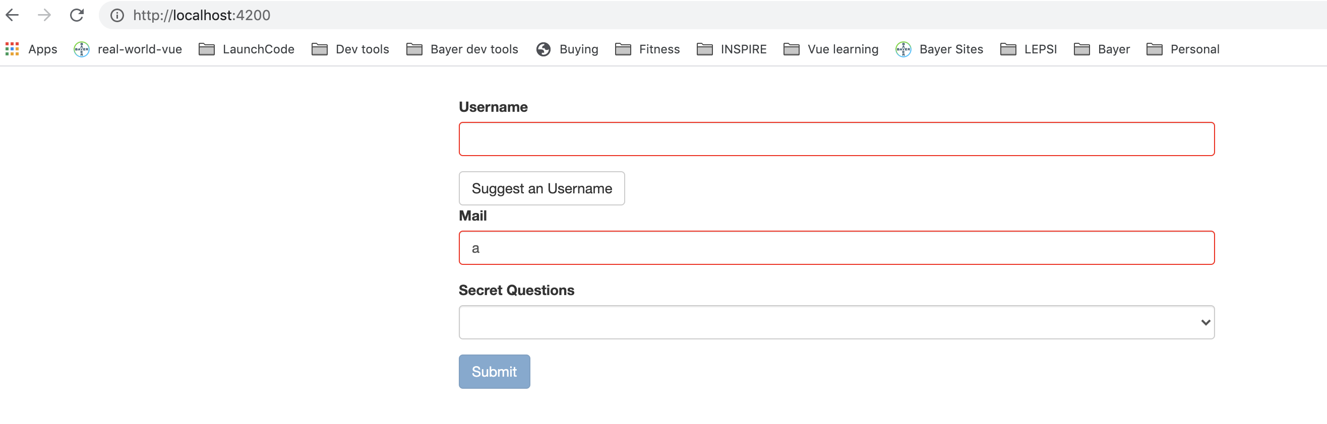
Change styling
The form is also invalid, so conditional styling needs to be applied just to element not entire form.
Notes:
27

Slide 28
Validation messages for user
Notes:
28

Slide 29
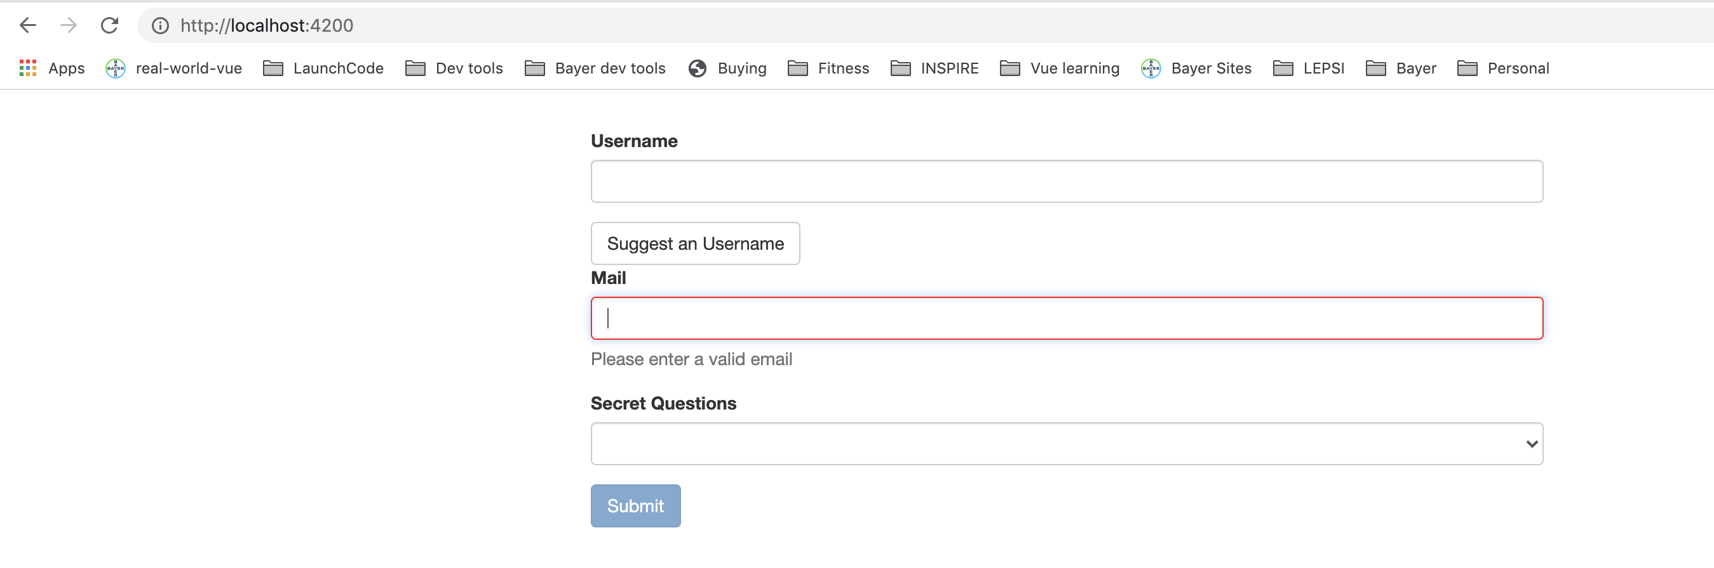
Validation messages for user
Notes:
29

Slide 30
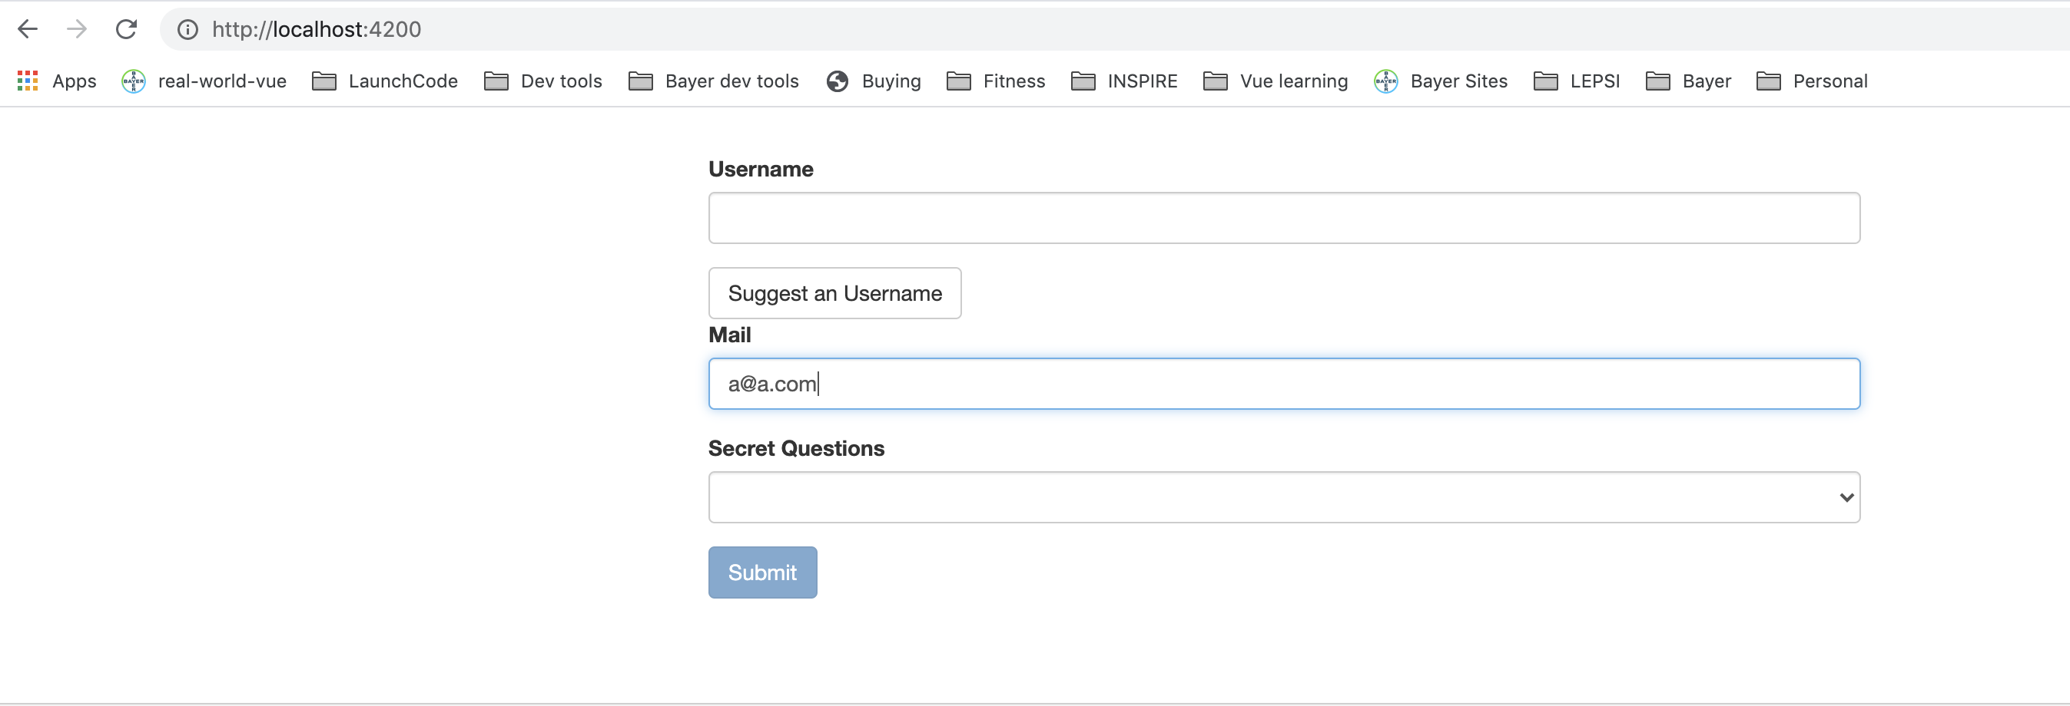
Validation messages for user
Notes:
30

Slide 31
Set Default Values for ngModel
Notes:
31

Slide 32
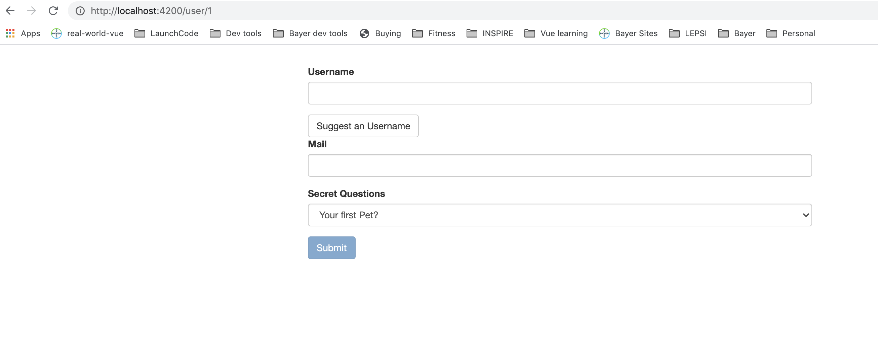
Set Default Values for ngModel
Notes:
32

Slide 33
Set Default Values for ngModel – add it to a property.
Notes:
33

Slide 34
Set Default Values for ngModel – add it to a property.
Notes:
34

Slide 35
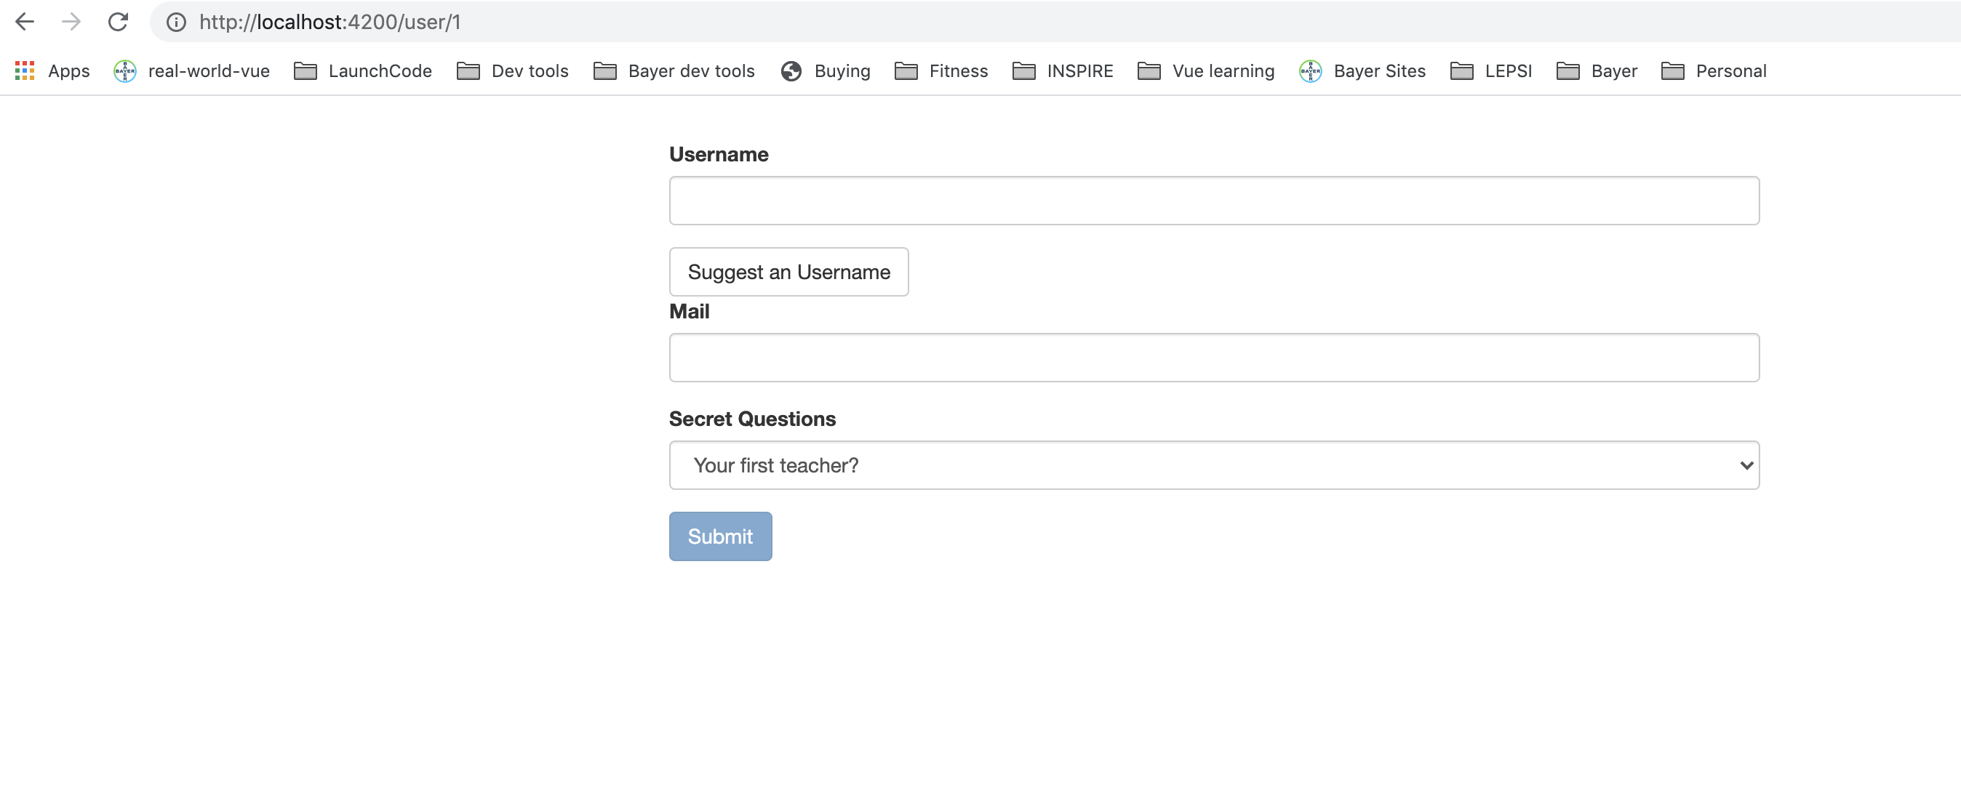
Set Default Values for ngModel – add it to a property.
Notes:
35

Slide 36
Using ngModel with two-way-binding
Notes:
36

Slide 37
Using ngModel with two-way-binding
Notes:
37

Slide 38
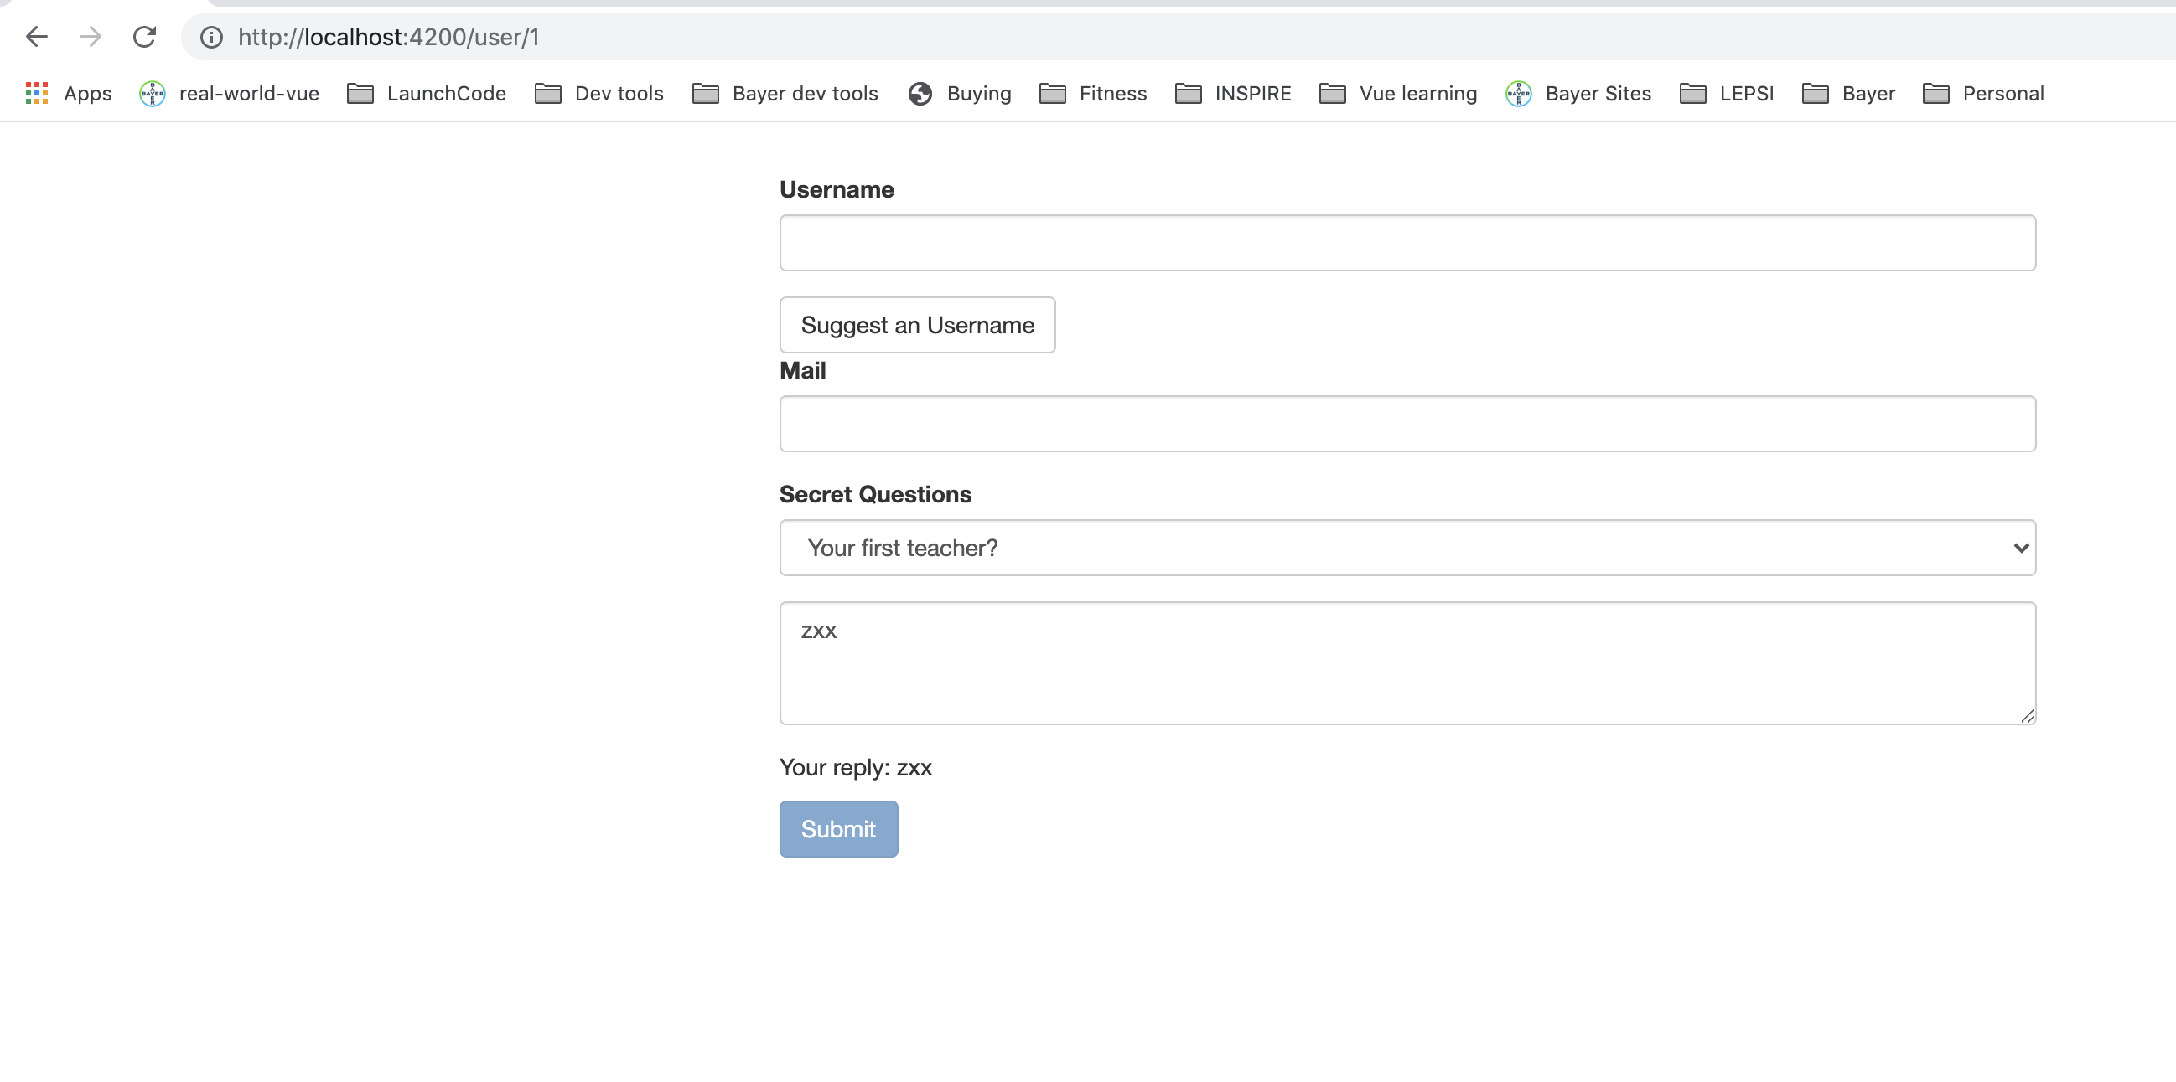
Using ngModel with two-way-binding
Notes:
38

Slide 39
Grouping form controls – structure in object.
If we use ngModelGroup and give it a string, then Angular creates a control group as well as a value group. Also get the html css to see validity etc.
Notes:
39

Slide 40
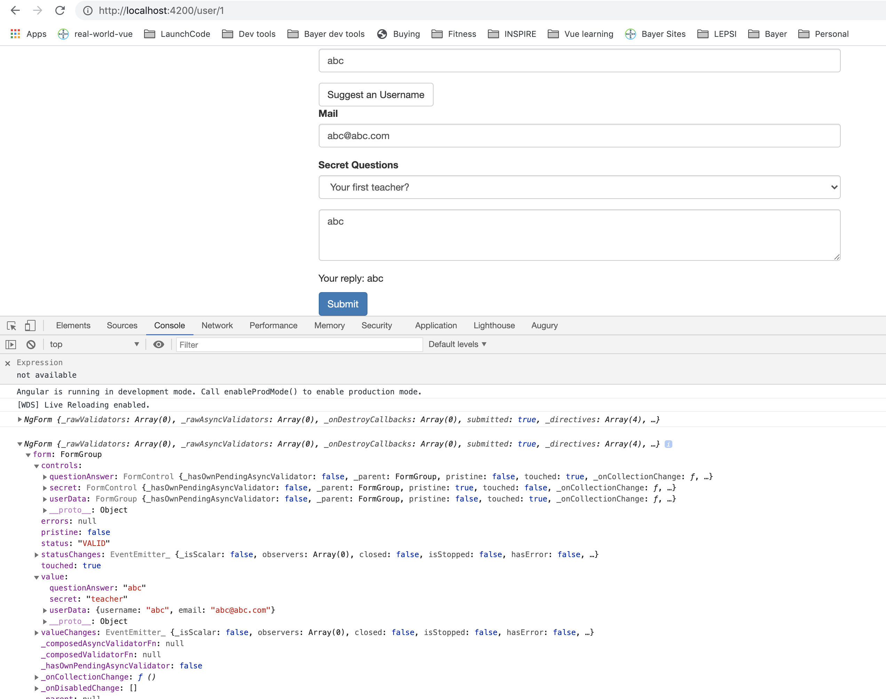
Grouping form controls – structure in object.
Notes:
40

Slide 41
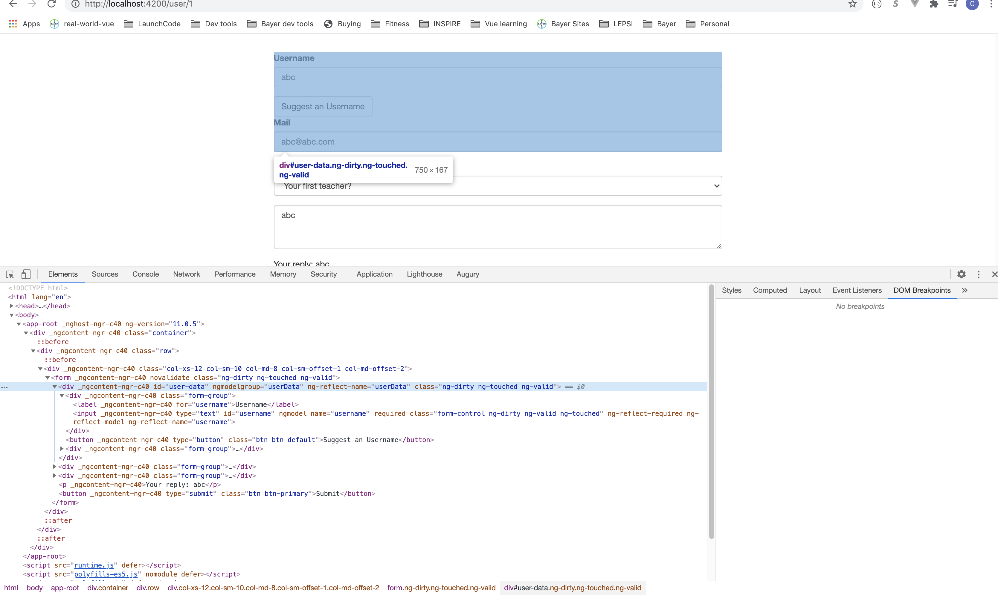
Grouping form controls – structure in object.
Notes:
41

Slide 42
Grouping form controls – structure in object.
You can create a local reference is use it to display validity of form on page.
Notes:
42

Slide 43
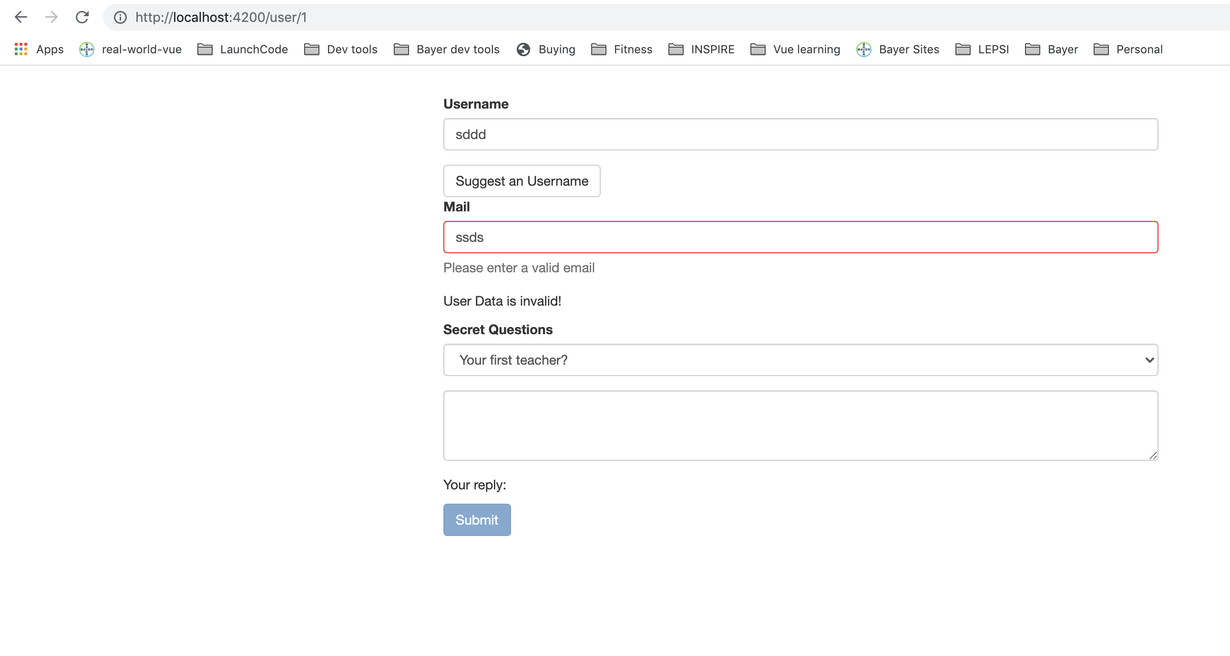
Grouping form controls – structure in object.
Notes:
43

Slide 44
Radio buttons.
Notes:
44

Slide 45
Radio buttons.
Notes:
45

Slide 46
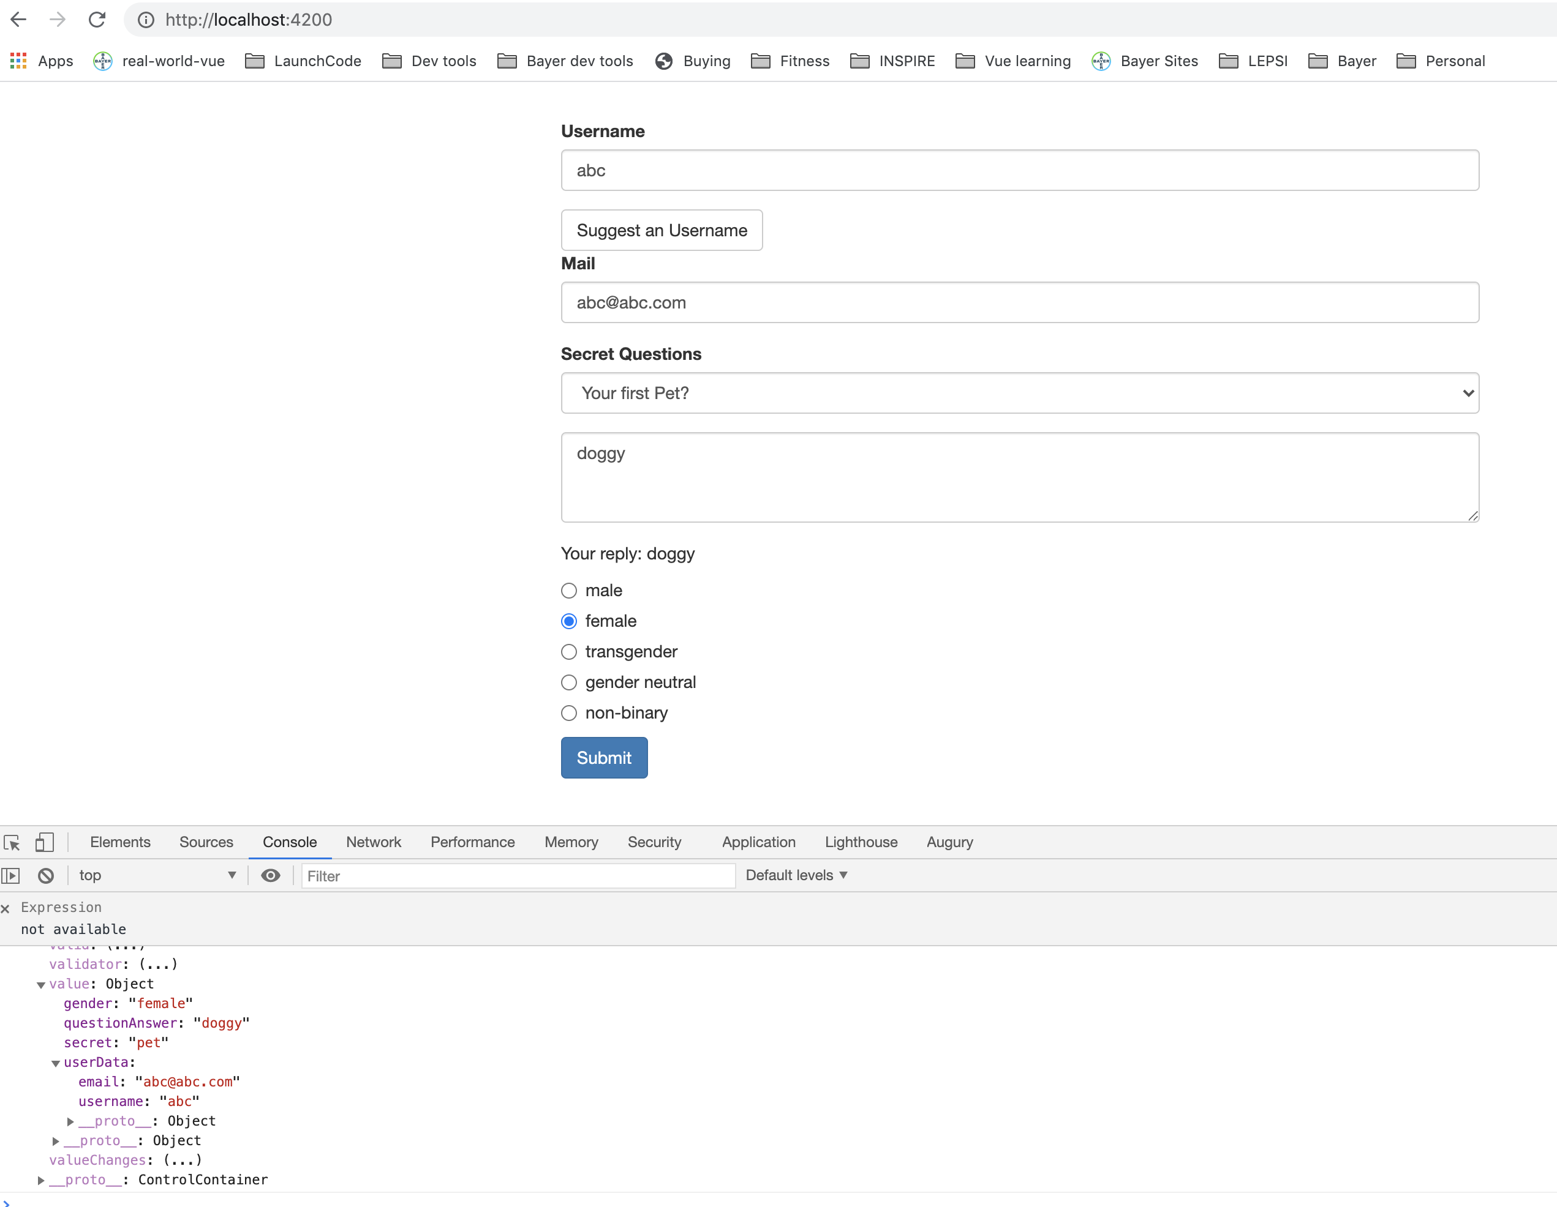
Radio buttons.
Notes:
Can also add required.
46

Slide 47
Setting and patching form values.
Suggest a username button doesn’t work, but we have some method present
Access to form using ViewChild
Notes:
47

Slide 48
Setting and patching form values.
Notes:
48

Slide 49
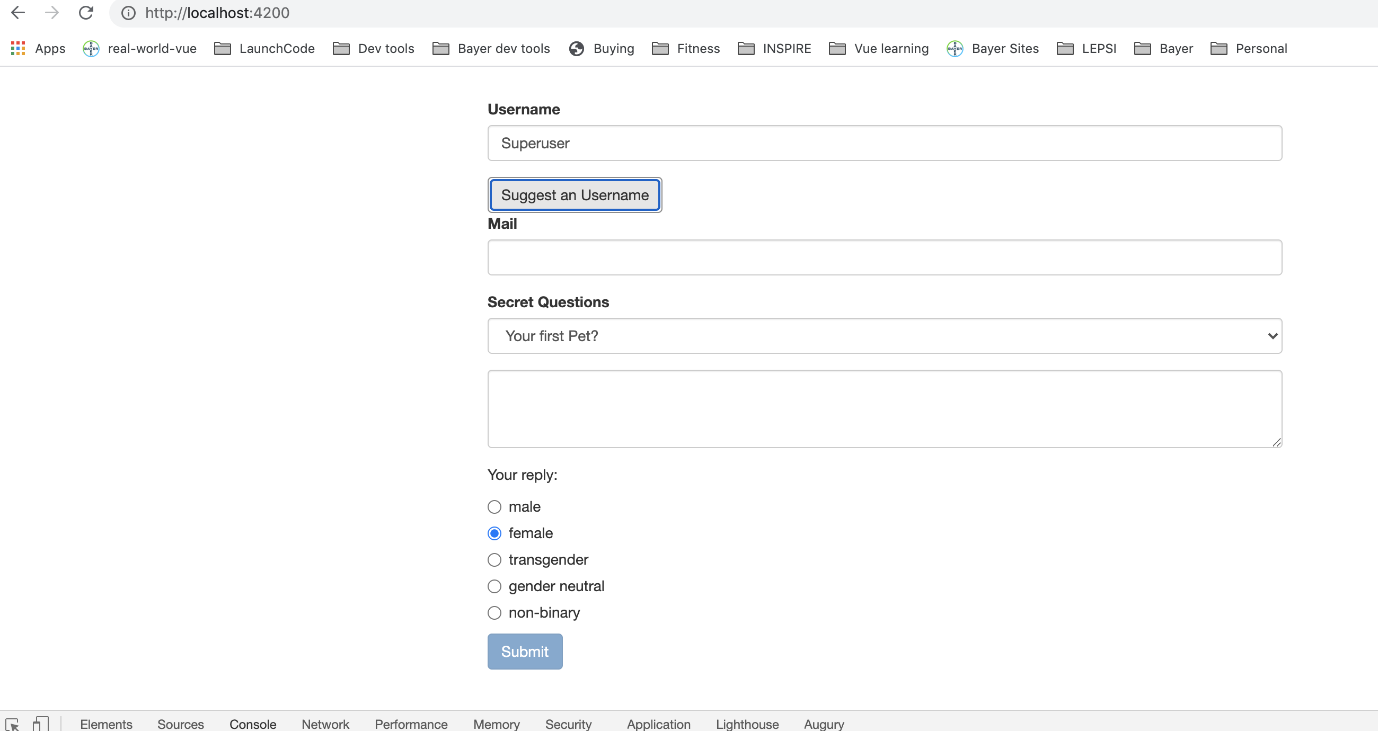
Setting and patching form values.
Notes:
49

Slide 50
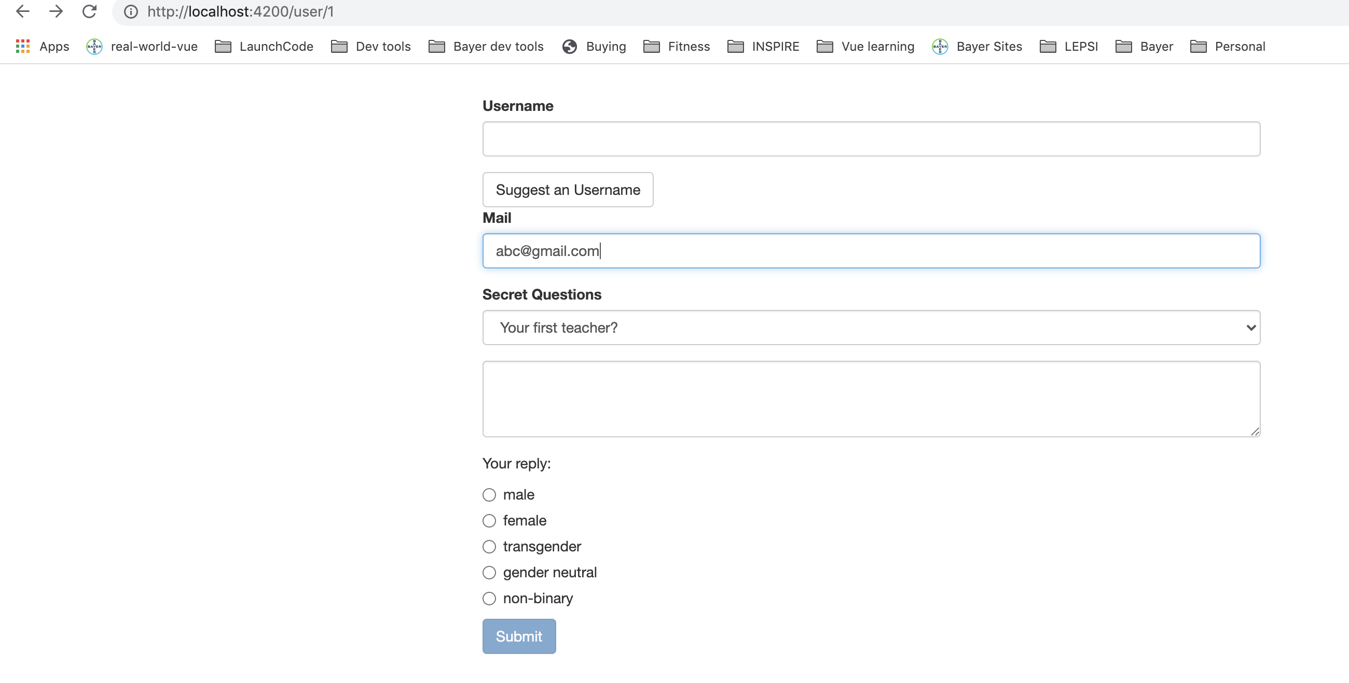
Setting and patching form values.
Notes:
50

Slide 51
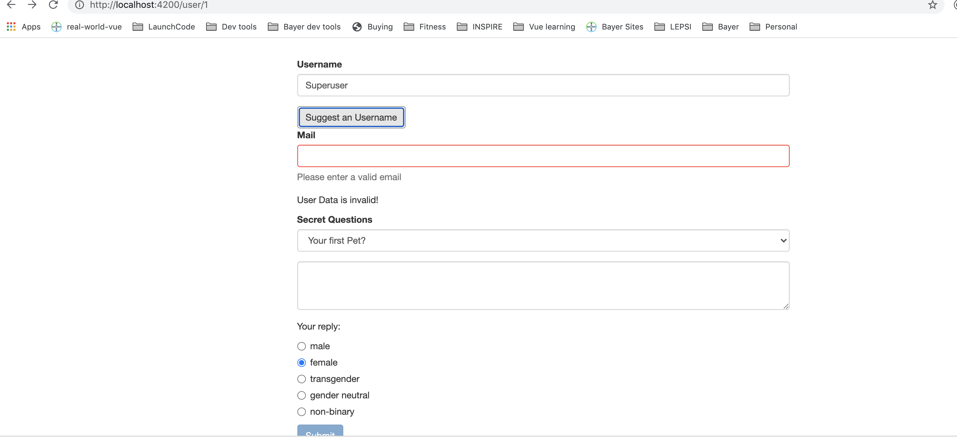
Setting and patching form values.
Notes:
51

Slide 52
Setting and patching form values.
Notes:
52

Slide 53
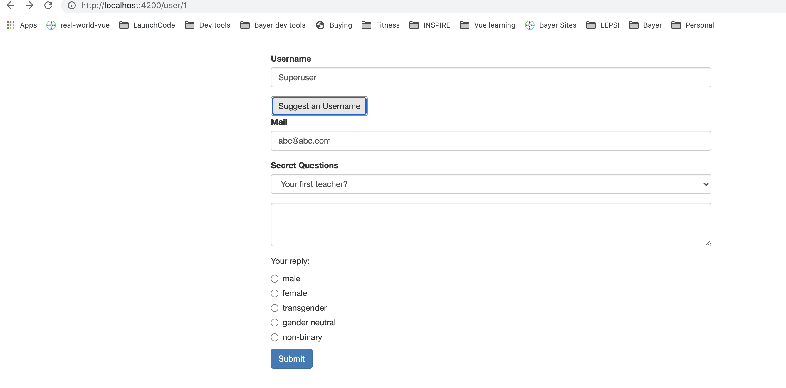
Setting and patching form values.
Notes:
53

Slide 54
Using Form Data.
Let’s summarize the submitted data.
Notes:
54

Slide 55
Using Form Data.
Notes:
55

Slide 56
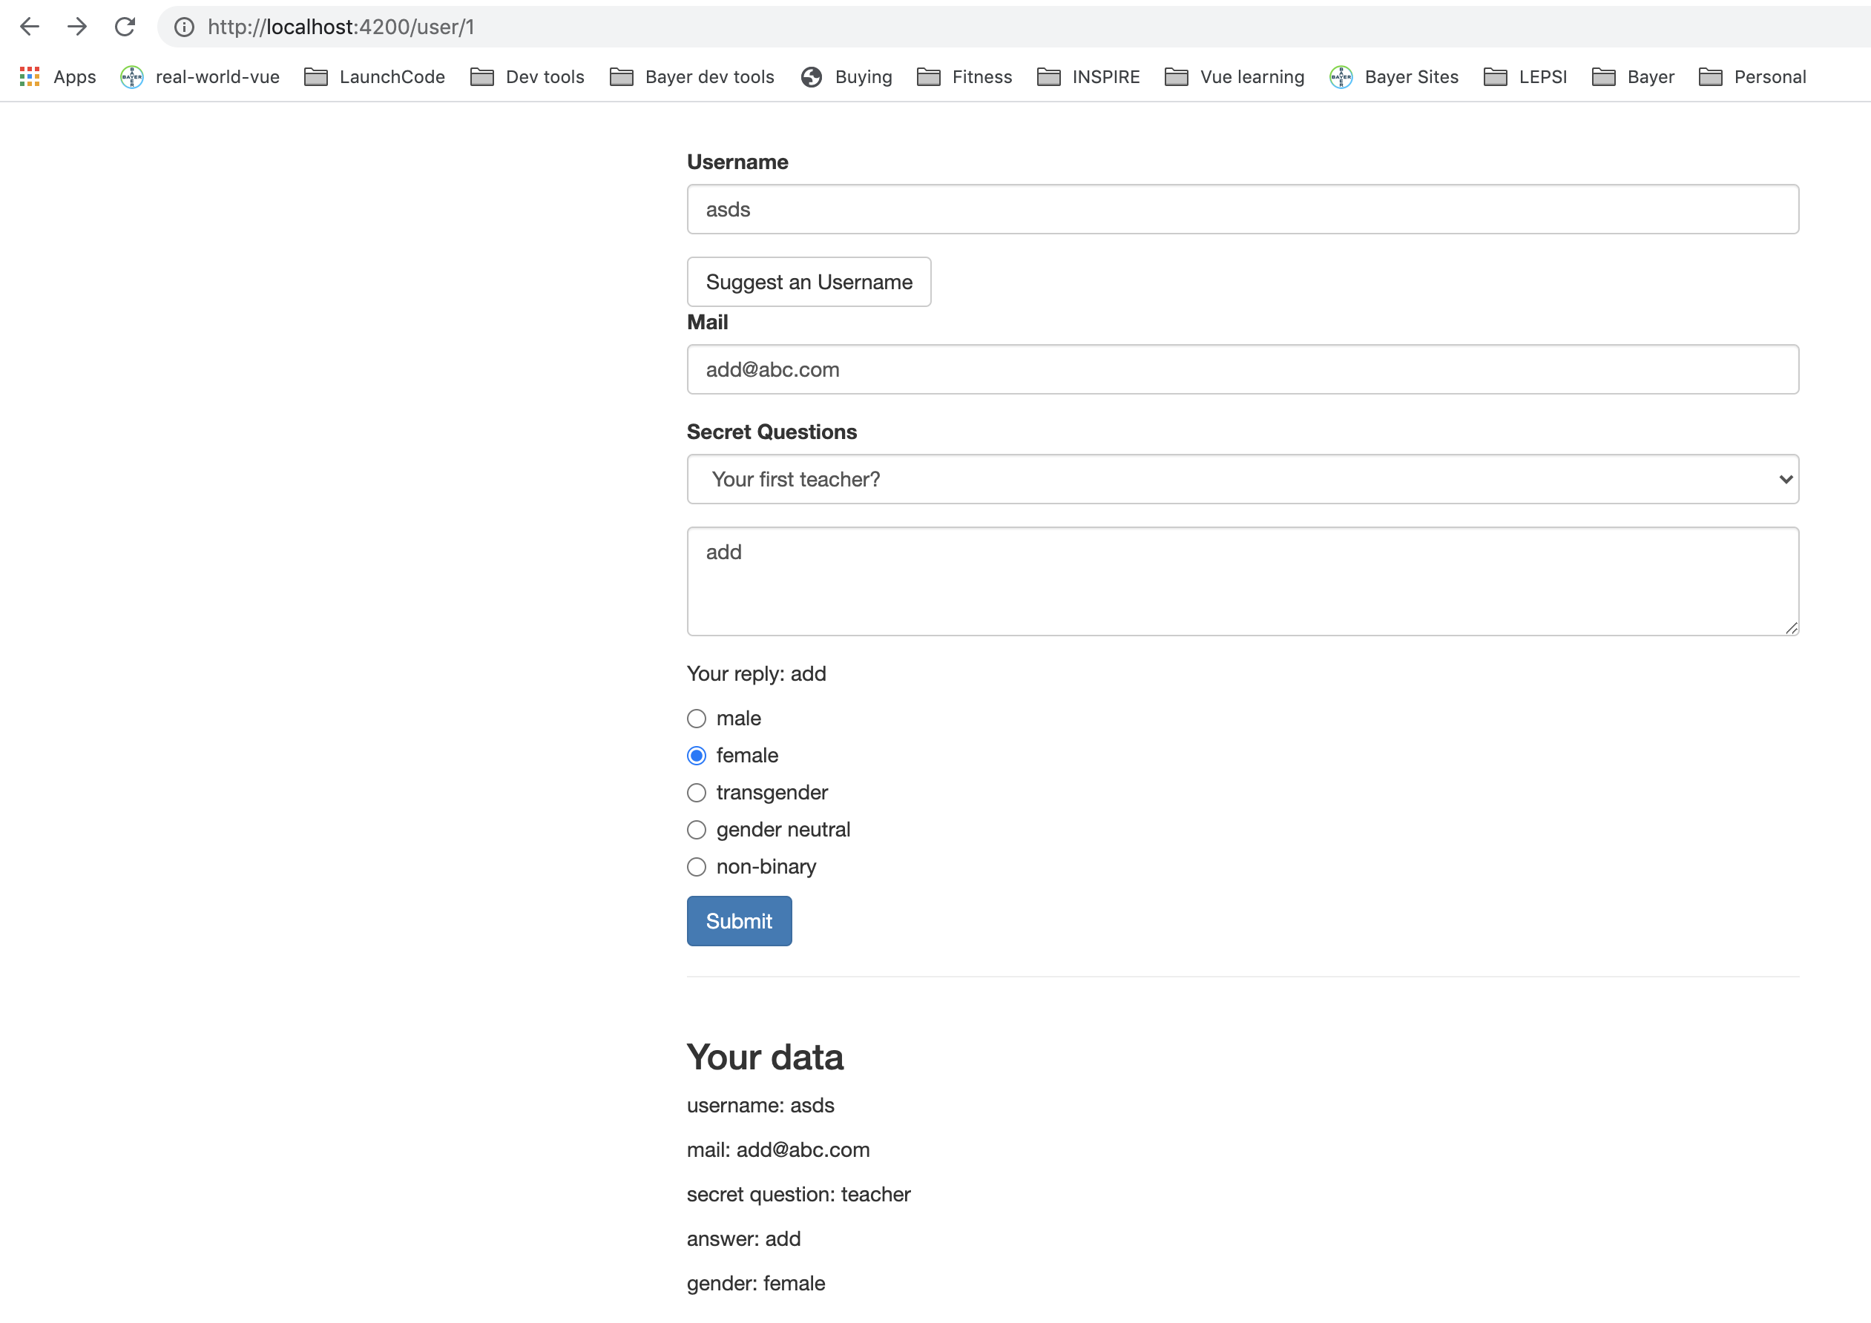
Using Form Data.
Let’s summarize the submitted data.
Notes:
56

Slide 57
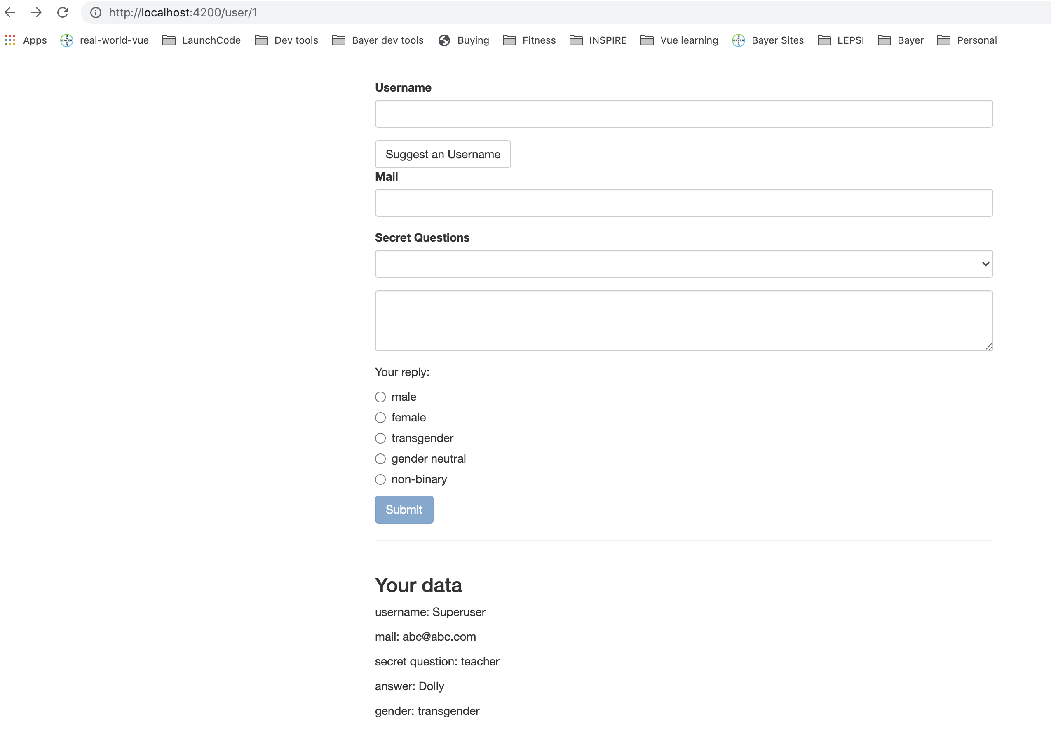
Resetting Form Data.
Extracted data and want to reset the form. It’s simple.
On the form, we can call reset to reset the values and also detach the properties.
this.signupForm.reset();
Notes:
57

Slide 58
Questions?

Slide 59
Studio
Assignment # 6
https://www.udemy.com/course/the-complete-guide-to-angular-2/learn/practice/276#overview

